Slide 1
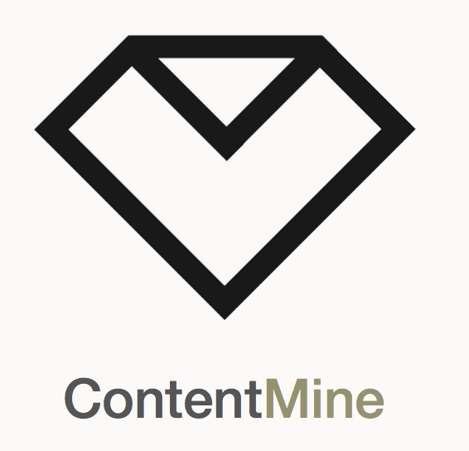




Young Scientists in an Age of Knowledge Neocolonialism
Peter Murray-Rust^{1,2}
[1]University of Cambridge
[2]TheContentMine
pm286 AT cam DOT ac DOT uk
Global Young Academy, Oxford UK, 2018-03-20
Let’s build a modern Open knowledgebase
which we, not megacorporations, control

Slide 2
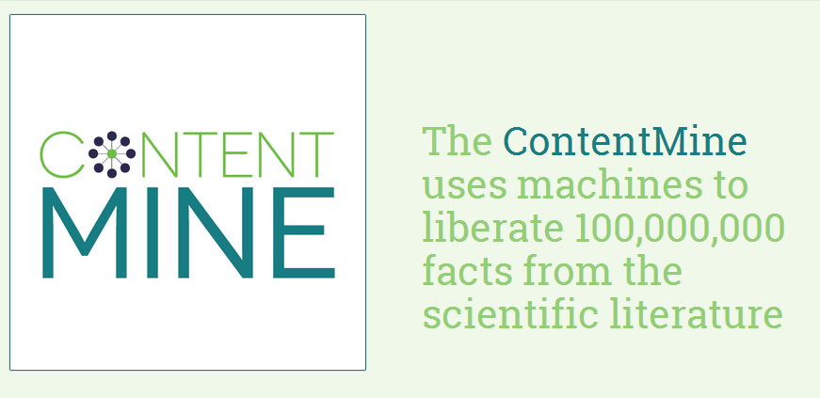

The Right to Read is the Right to Mine*
*PeterMurray-Rust, 2011
http://contentmine.org

Slide 3
Opening Knowledge overcomes injustice
Open comes from the heart.
Closed Access Means People Die.
Megacorporations are pwning the knowledge infrastructure/
The Right to Read is the Right to Mine
Young people change the world. Give them the chance.
ACT: Advocacy , Community, Tools
Congratulations on Global Access to Research Software

Slide 4
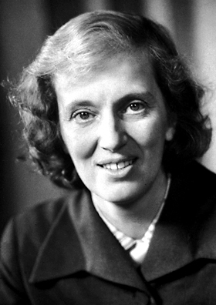
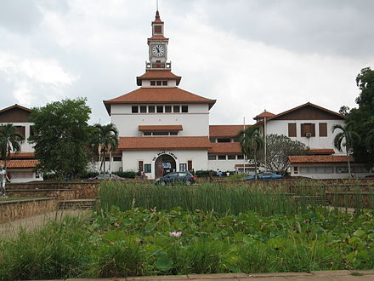
My gratitude to Dorothy Hodgkin, mentor
and Ghana/Ghanaians 1963-1965
Dorothy
Hodgkin
(Nobel Laureate, Oxford, Ghana and the whole world
University of Ghana, Legon, Accra, Ghana
Images: Wikimedia Commons

Slide 5
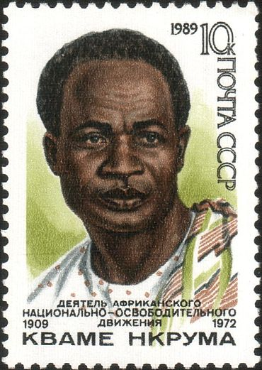
Neocolonialism
In place of colonialism, as the main instrument of imperialism, we have today neo-colonialism . . . [which] like colonialism, is an attempt to export the social conflicts of the capitalist countries. . . .
The result of neo-colonialism is that foreign capital is used for the exploitation rather than for the development of the less developed parts of the world. Investment, under neo-colonialism, increases, rather than decreases, the gap between the rich and the poor countries of the world. The struggle against neo-colonialism is not aimed at excluding the capital of the developed world from operating in less developed countries. It is aimed at preventing the financial power of the developed countries being used in such a way as to impoverish the less developed.[5]
Kwame Nkrumah 1965 Neo-Colonialism, The Last Stage of Imperialism.
Text and Image: Wikimedia Commons

Slide 6
Knowledge Neocolonialism/Capitalism
The result of [knowledge colonialism] is that [corporate] capital is used for the exploitation rather than for the development of the less developed parts of the [knowledge] world.
Investment, under [knowledge imperialism], increases, rather than decreases, the gap between the rich and the poor [scholars] of the world. The struggle against [knowledge neocolonialism] […] is aimed at preventing the financial power of the [megacorporations] being used in such a way as to impoverish the less developed.[5]
(adapted by PMR from Kwame Nkrumah) s/country/scholar/, s/colonial power/megacorporation/

Slide 7
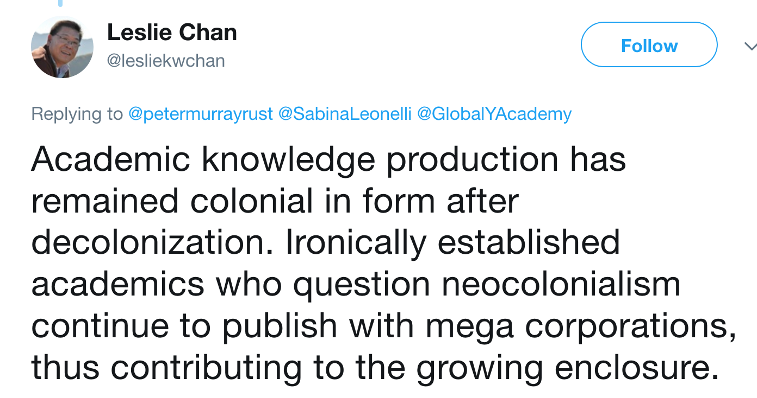
Immediate reply from Leslie Chan

Slide 8
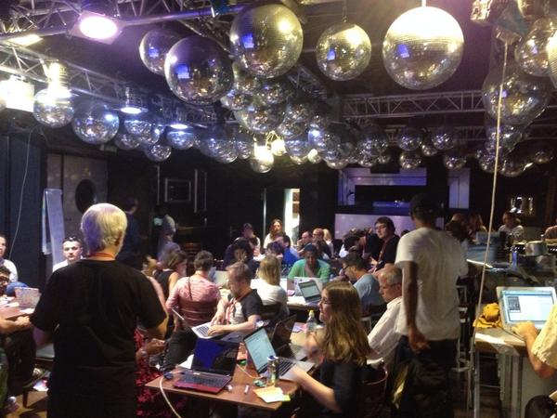
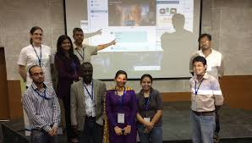
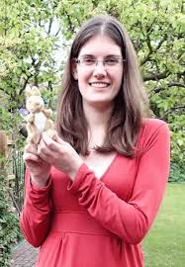
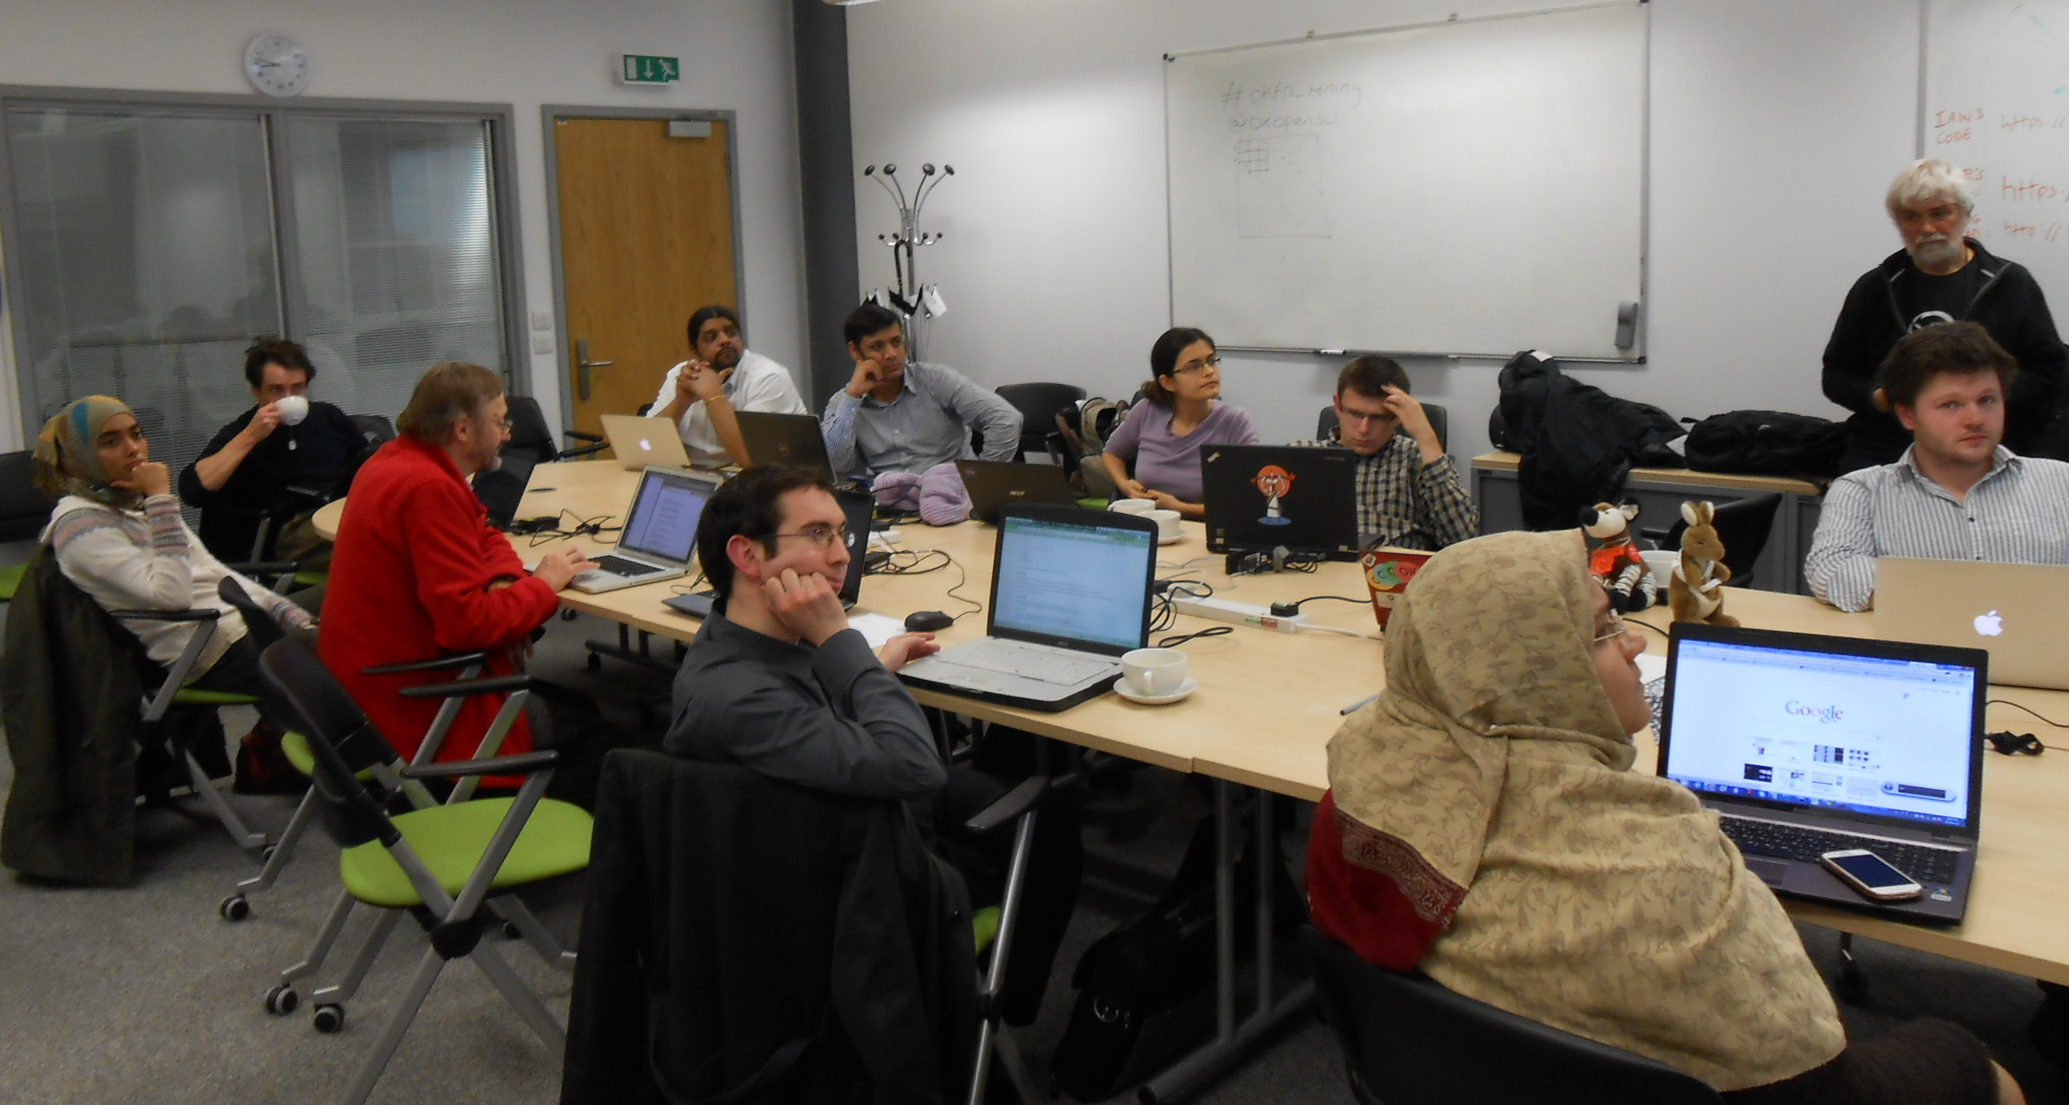
Berlin 2014
Gita Yadav + colleagues
Delhi 2014
Oxford 2013
Jenny Molloy with mascot AMI

Slide 9
Why Open?
Better
Quicker
Flexible
Inclusive
Preservable
Principled

Slide 10
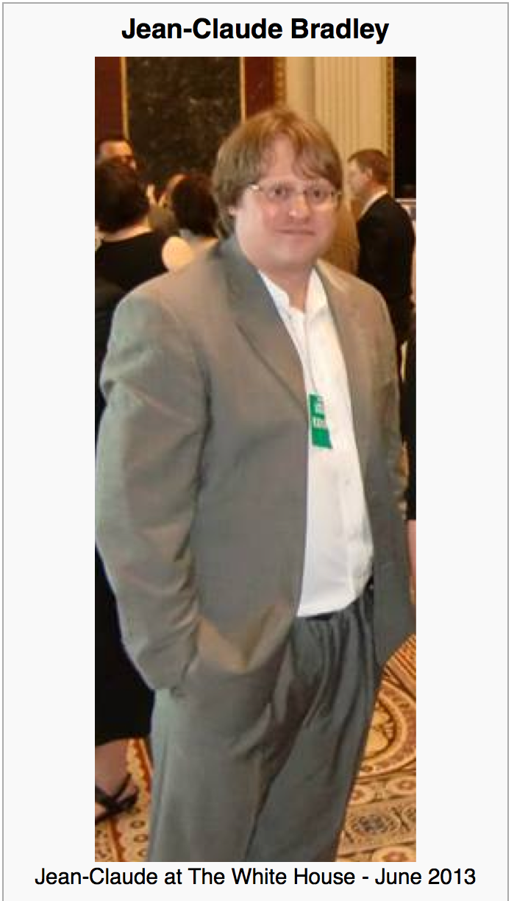

Jean-Claude Bradley
Jean-Claude Bradley was one of the most influential open scientists of our time. He was an innovator in all that he did, from Open Education to bleeding edge Open Science; in 2006, he coined the phrase Open Notebook Science. His loss is felt deeply by friends and colleagues around the world.
On Monday July 14, 2014 we gathered at Cambridge University to honour his memory and the legacy he leaves behind with a highly distinguished set of invited speakers to revisit and build upon the ideas which inspired and defined his life’s work.
Wikipedia CC BY-SA
Notes:
Hi, I’m here to talk about AMI; a data extraction framework and tool. First, I just want highlight some of key contributors to the projects; Andy for his work on the ChemistryVisitor and Peter for the overall architecture.
In this talk, I’m going to impress the importance of data in a specific format and its utility to automated machine processing. Then I’m going to demonstrate AMI’s architecture and the transformation of data as it flows through the process. I’m going to dwell a little on a core format used, Scalable Vector Graphics (SVG) before introducing the concept of visitors, which are pluggable context specific data extractors. Next, I’m going to introduce Andy’s ChemVisitor, for extracting semantic chemistry data, along with a few other visitors that can process non-chemistry specific data. Finally, I will demonstrate some uses of the ChemVisitor, within the realm of validation and metabolism.

Slide 11
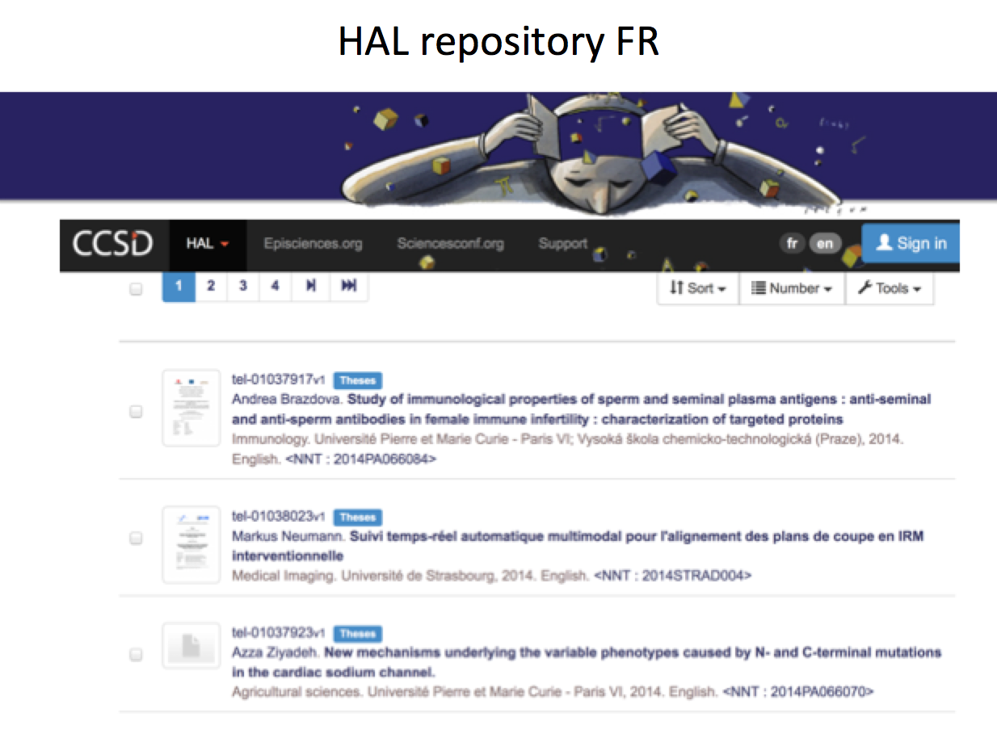
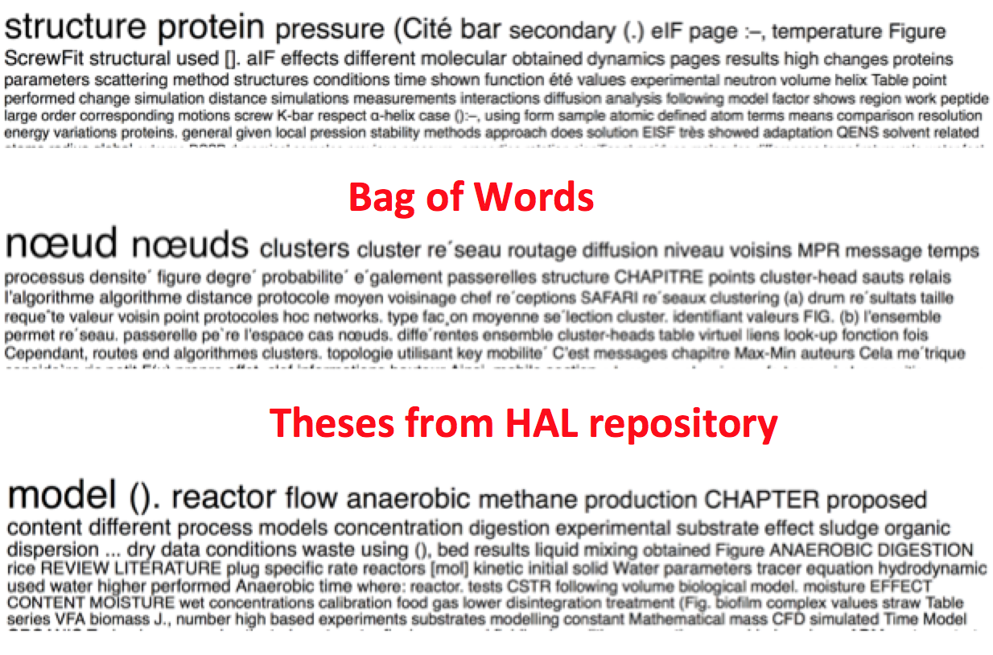
Value and use your thesis!
2018-03-18 Amelia Hunt (final year hons Edinburgh) researching Open Notebook Science by interviewing PMR and other practitioners. Dissertation will be deposited in Repository under Open licence.

Slide 12
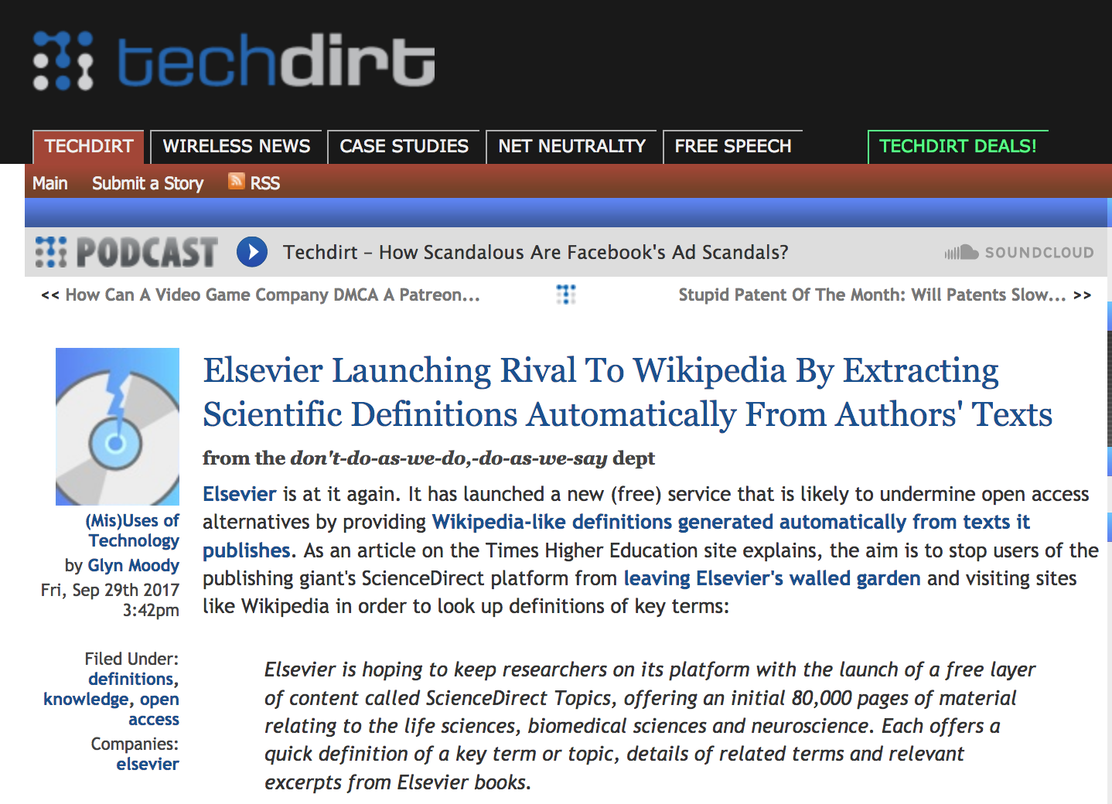

Slide 13
The Publisher-Academic complex[1]
$$, MS
review
Taxpayer
$$
$$
Publishers
Academia
Student
Glory+?
in-kind
Infrastructure
Researcher
“The scholarly poor”
[1] The Military-Industrial-Academic complex (1961)
(Dwight D Eisenhower, US President)

Slide 14
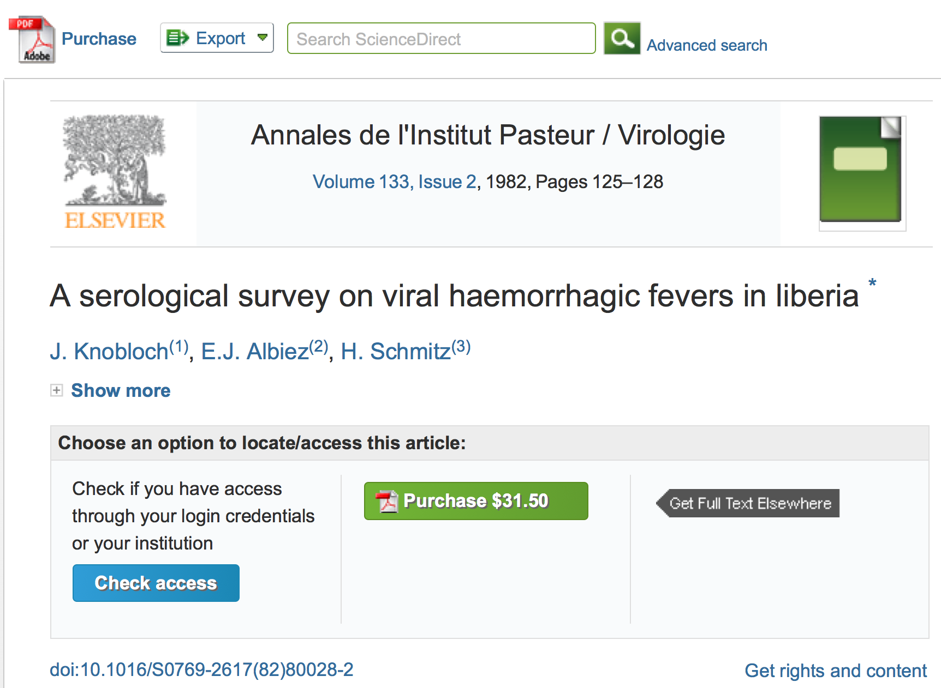
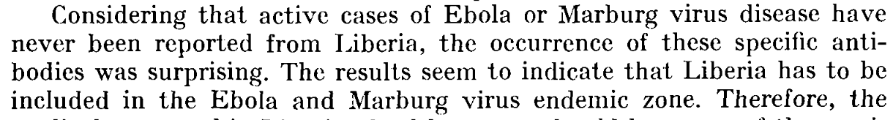

Slide 15
A System Failure of Scholarly Publishing
http://www.nytimes.com/2015/04/08/opinion/yes-we-were-warned-about-ebola.html
We were stunned recently when we stumbled across an article by European researchers in Annals of Virology [1982]: “The results seem to indicate that Liberia has to be included in the Ebola virus endemic zone.” In the future, the authors asserted, “medical personnel in Liberian health centers should be aware of the possibility that they may come across active cases and thus be prepared to avoid nosocomial epidemics,” referring to hospital-acquired infection.
Adage in public health: “The road to inaction is paved with research papers.”
Bernice Dahn (chief medical officer of Liberia’s Ministry of Health)
Vera Mussah (director of county health services)
Cameron Nutt (Ebola response adviser to Partners in Health)

Slide 16

Scholarly publishing is “Big Data”
1 year’s scholarly output!
$500 Billion public research => 2.5 million articles /year , 7000 /day
Most is not Publicly readable and much is unused
ContentMining (TDM) can liberate knowledge
Many mega-publishers fight ContentMining
[1] http://www.crossref.org/01company/crossref_indicators.html
[2] https://en.wikipedia.org/wiki/Mont_Blanc#/media/File:Mont_Blanc_depuis_Valmorel.jpg

Slide 17
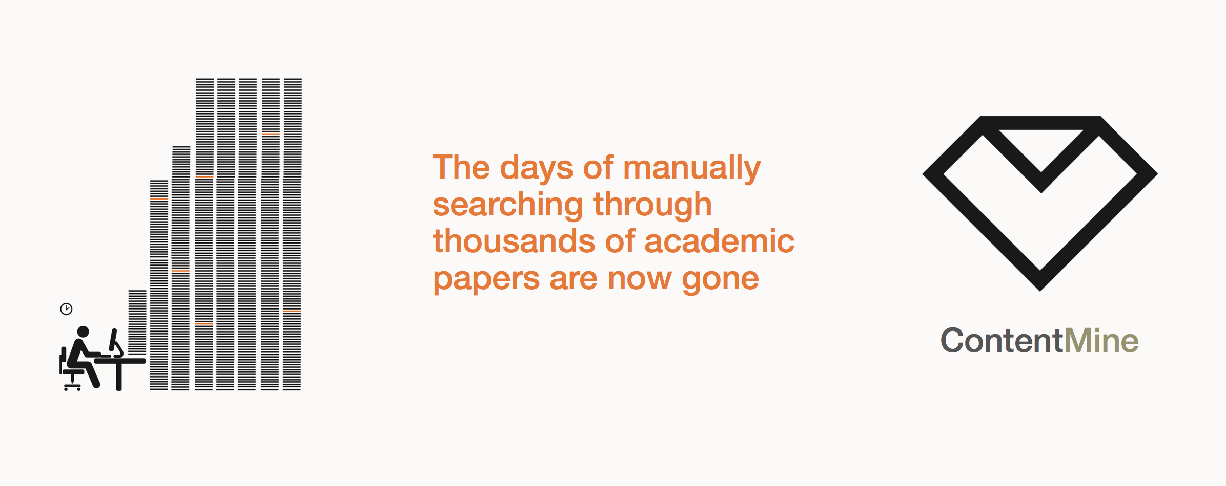
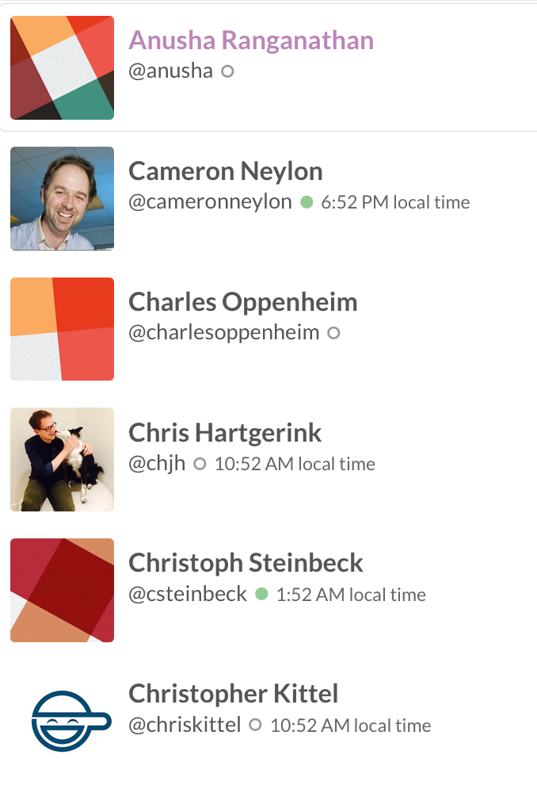
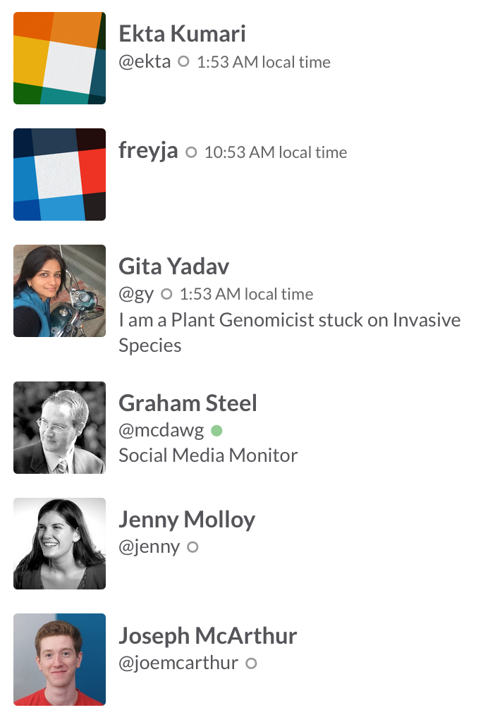
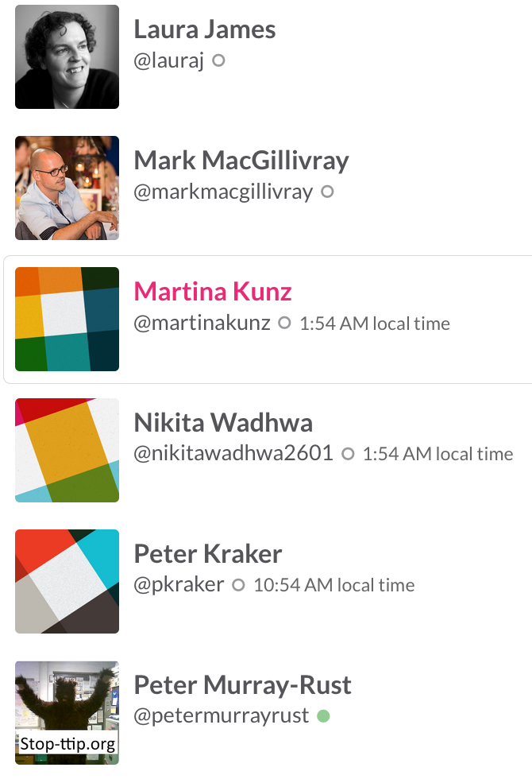
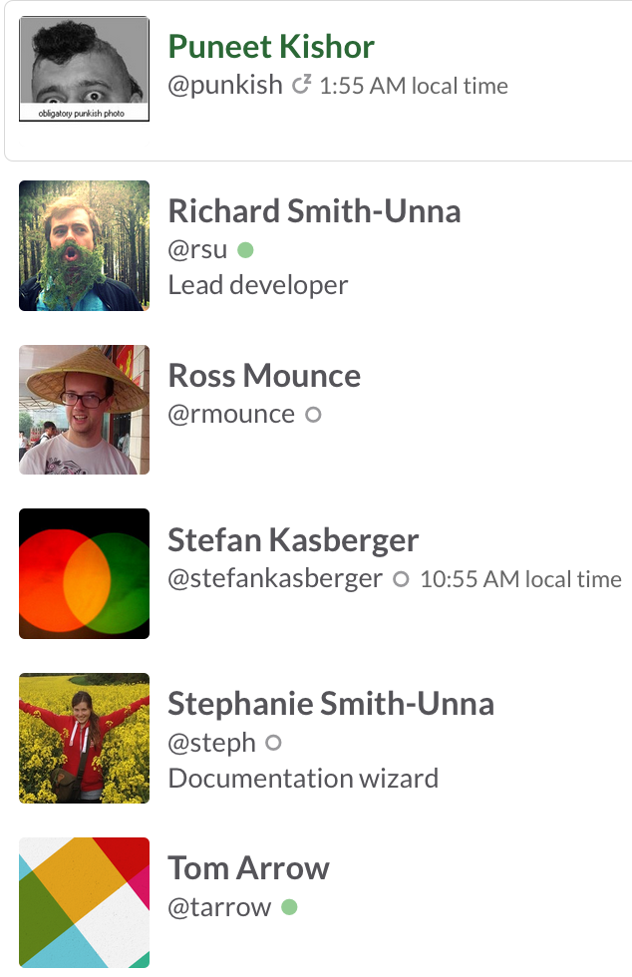
The Right to Read is the Right to Mine
Mining millions of Open facts every week
(2x digital music industry!)
ContentMine is an OpenLocked Non-Profit company

Slide 18
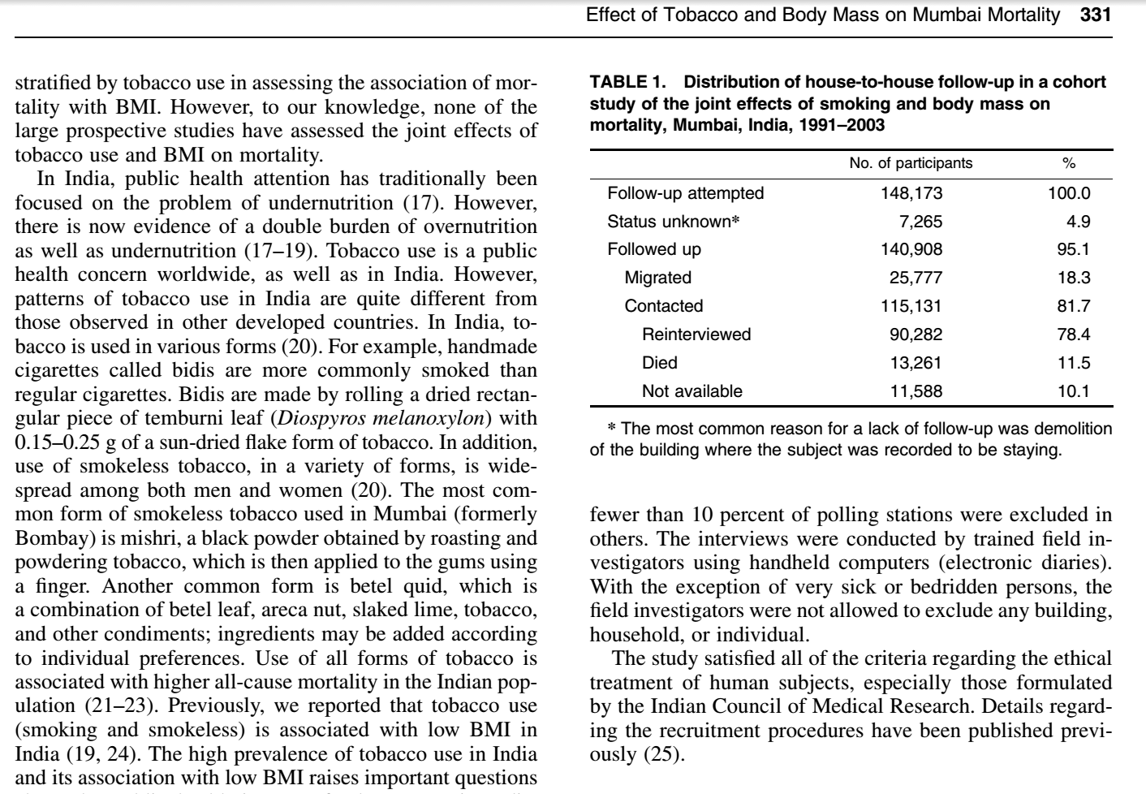
Polly: “there were 10,000 abstracts and due
to time pressures, we split this between 6 researchers. It took about 2-3 days of work (working only on this) to get through
~1,600 papers each. So, at a minimum this
equates to 12 days of full-time work (and would normally be done over several weeks under normal time pressures).”
ContentMine software can do this in a few minutes

Slide 19
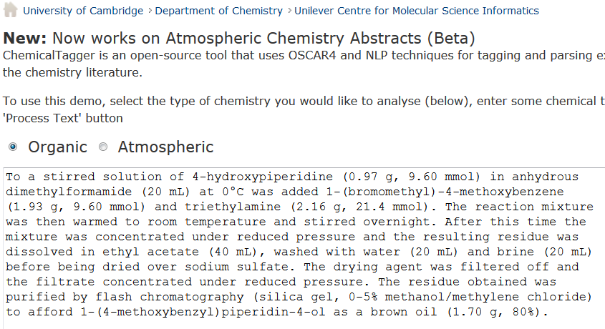
http://chemicaltagger.ch.cam.ac.uk/
Typical
Typical chemical synthesis

Slide 20
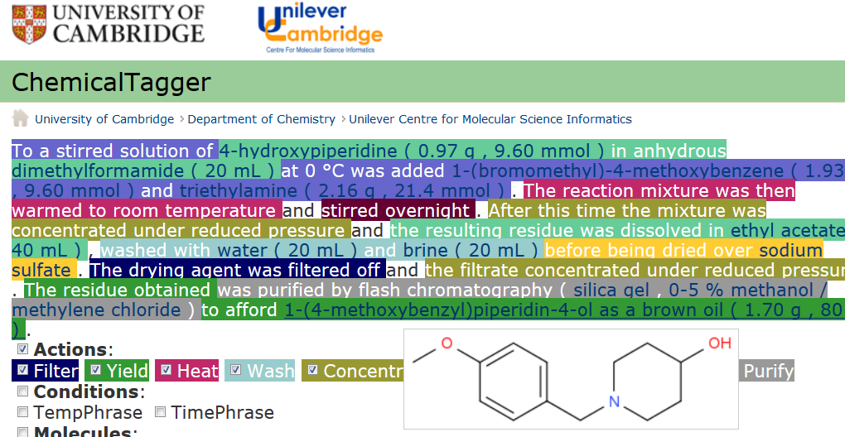
Automatic semantic markup of chemistry
Could be used for analytical, crystallization, etc.

Slide 21
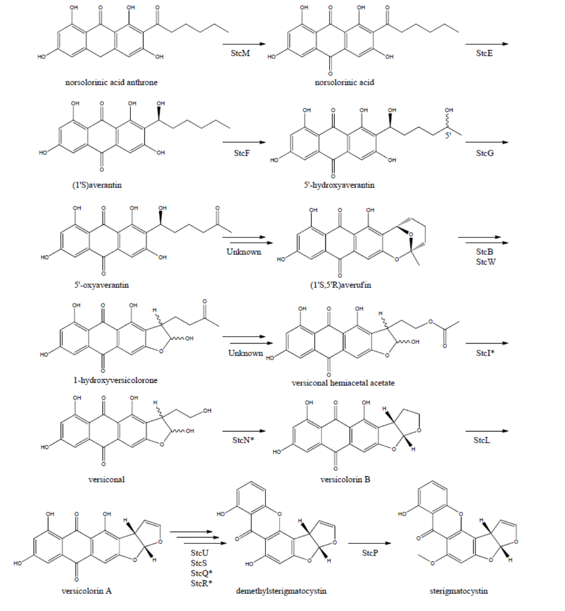
AMI https://bitbucket.org/petermr/xhtml2stm/wiki/Home
AMI reads the complete diagram, recognizes the paths and generates the molecules. Then she creates a stop-fram animation showing how the 12 reactions lead into each other
CLICK HERE FOR ANIMATION
(may be browser dependent)
Example reaction scheme, taken from MDPI Metabolites 2012, 2, 100-133; page 8, CC-BY:

Slide 22
http://www.budapestopenaccessinitiative.org/read
… an unprecedented public good. …
… completely free and unrestricted access to [peer-reviewed literature] by all scientists, scholars, teachers, students, and other curious minds. …
…Removing access barriers to this literature will accelerate research, enrich education, share the learning of the rich with the poor and the poor with the rich, make this literature as useful as it can be, and lay the foundation for uniting humanity in a common intellectual conversation and quest for knowledge.
(Budapest Open Access Initiative, 2003)

Slide 23
BENEFITS OF CONTENT MINING
Hague Declaration 2015
Addressing grand challenges such as climate change and global epidemics
Improving population health, wealth and development
Creating new jobs and employment
Exponentially increasing the speed and progress of science through new insights and greater efficiency of research
Increasing transparency of governments and their actions
Fostering innovation and collaboration and boosting the impact of open science
Creating tools for education and research
Providing new and richer cultural insights
Speeding economic and social development in all parts of the globe

Slide 24
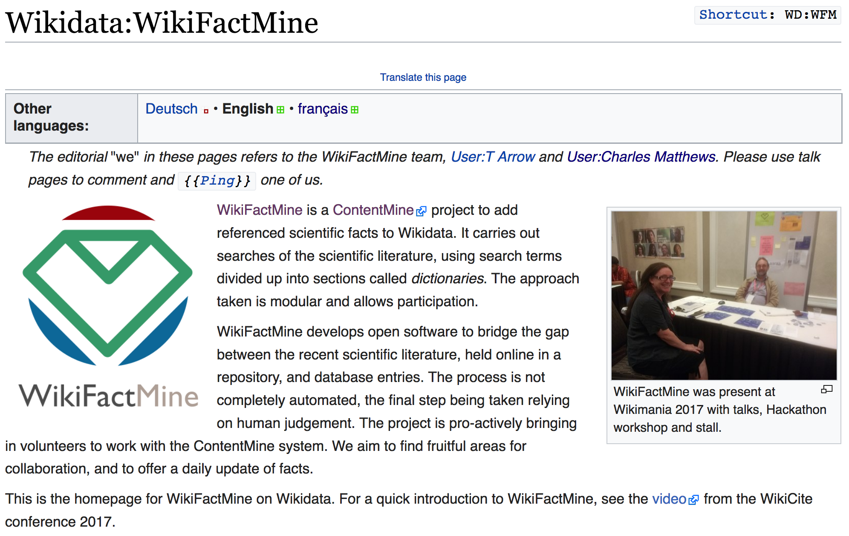
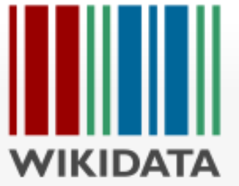


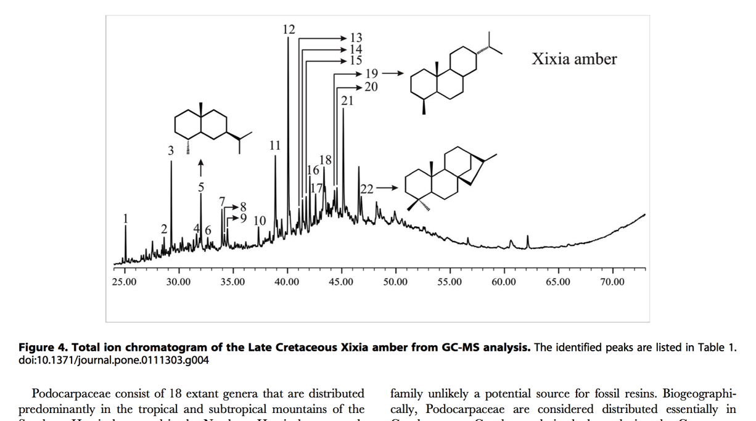
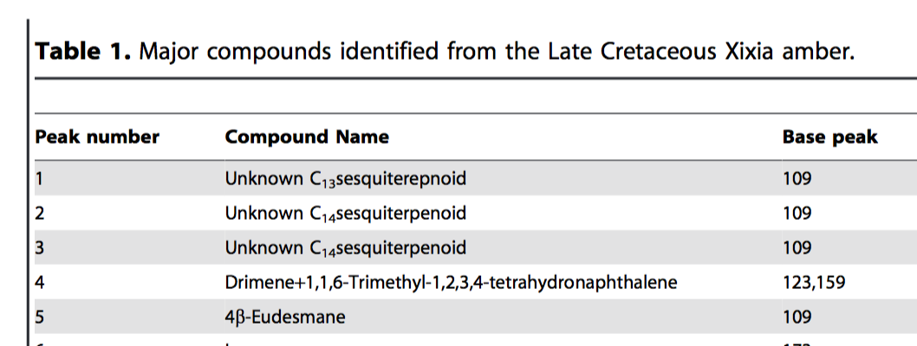


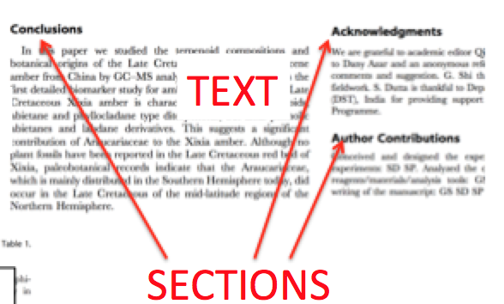
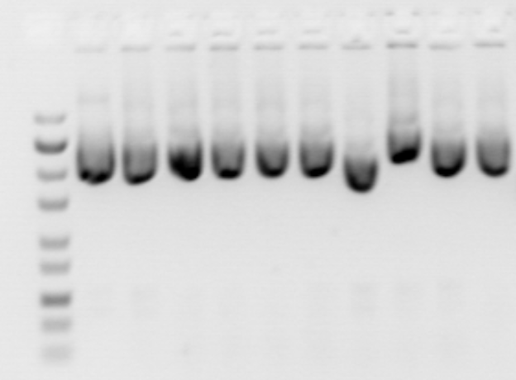

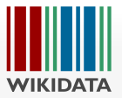
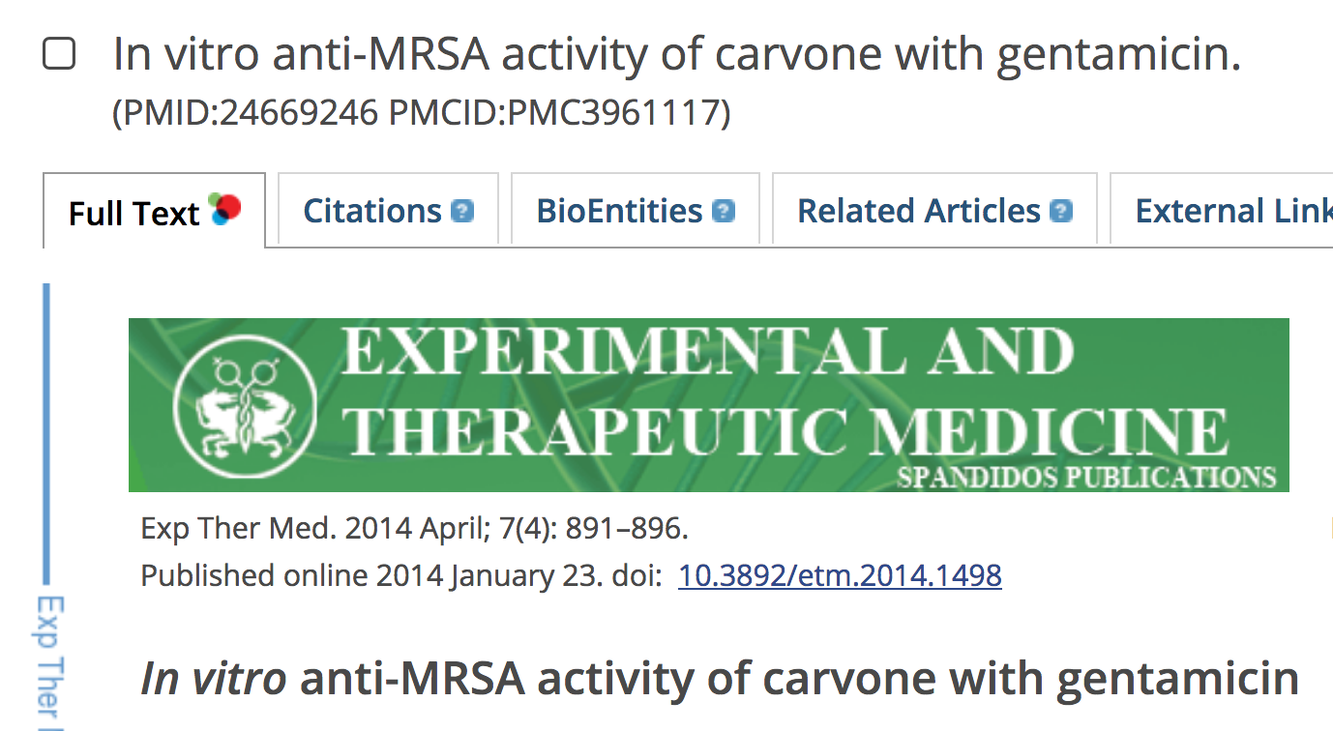
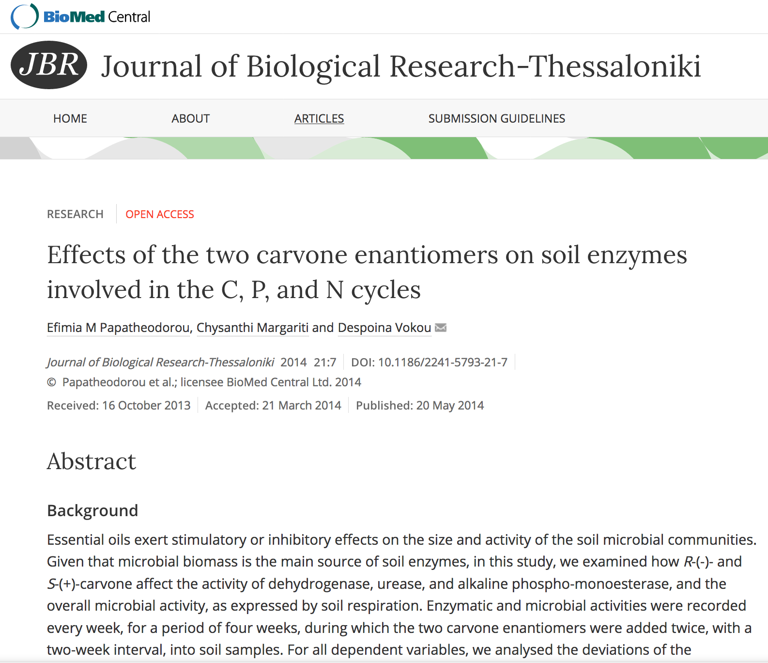

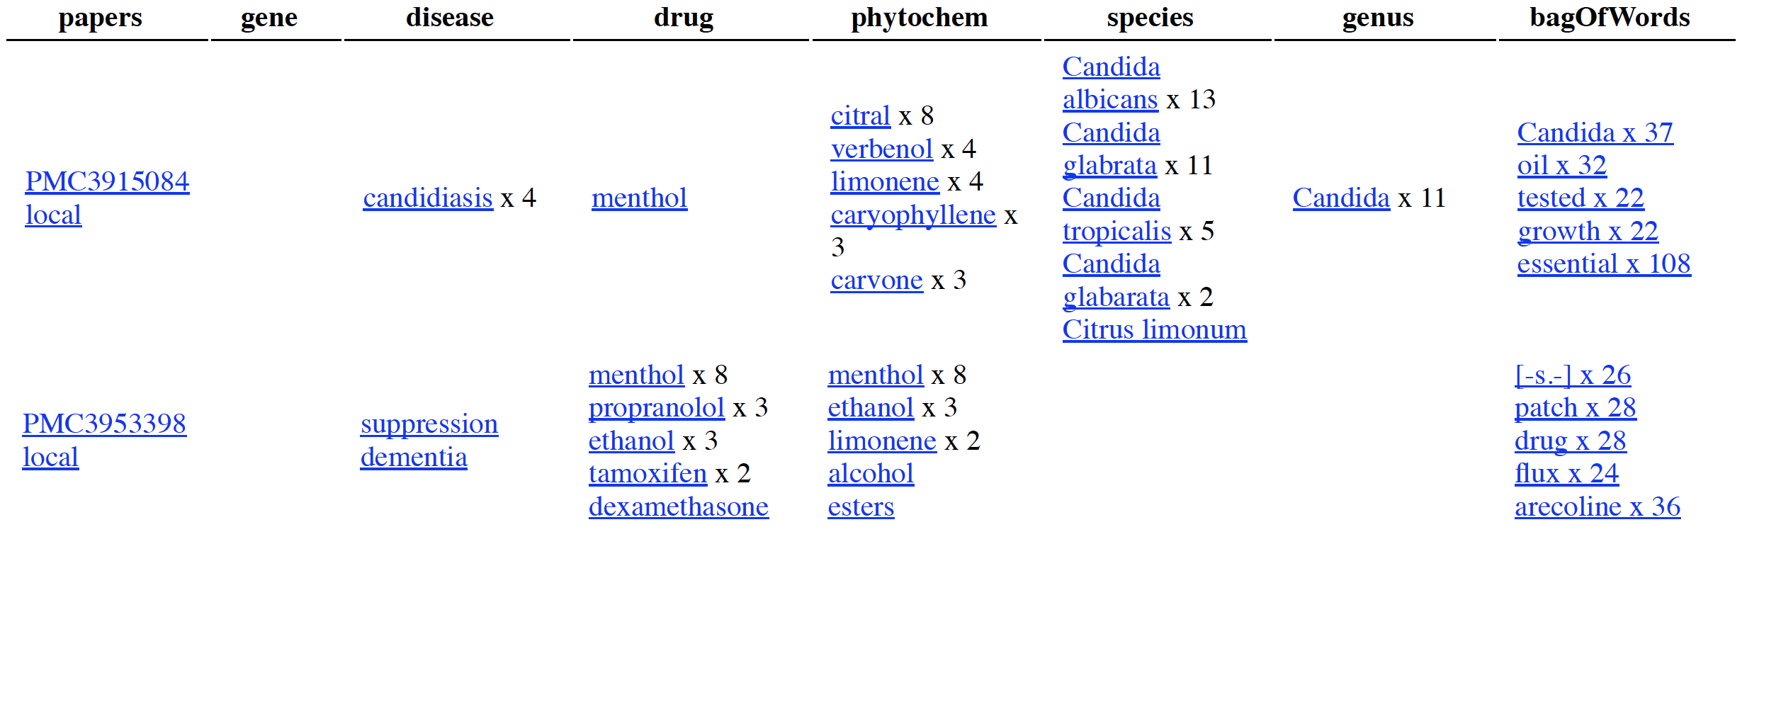

7 million articles, over 200 dictionaries
https://www.wikidata.org/wiki/Wikidata:WikiFactMine
ContentMine thanks the WikimediaFoundation for support
Search Strategies.
(A) Daily search. All new Open publications (300-1000) on EuropePMC are downloaded to WikimediaLabs, indexed by dictionaries, and the extracted facts (dictionary hits) stored in Zenodo (CERN’s Open repository) . Each paper may have hundreds or thousands of facts.
(B) On-Demand. A researcher, especially those doing systematic reviews. creates a fairly general query in her field with a range of dates, journals, etc. and downloads papers (getpapers and quickscrape) . The papers are filtered locally with a much more precise query (norma/ami).
A
B
Researcher FileStore
Publisher Sites
A. All EPMC papers are downloaded every day and the facts are extracted into Zenodo and made publicly available.
Data
Figures
getpapers
quickscrape
Text
Genes
Species
Tidying (PDF)
Tagging
Science Search
Data Search
All daily
Phytochem
B. Researcher searches repositories and also scrapes publisher sites for whatever chunk of the literature she wants. She runs local dictionaries and saves the results to disk where they can be further analyzed. She can add any papers she has legal access to and re-run whenever required. E.g. Bag Of Words is a powerful tool for classifying papers
Diseases
Drugs
Norma/
ami
30, 000 pages/day
Dictionary Search
Researcher FileStore
Automatically Extracted Indexed Facts

Slide 25
Some WikiFactMine dictionaries*
Galaxies
Aviation accidents and incidents
Sovereign states
soil types
100+ plant dictionaries
* Compiled by Charles Matthews

Slide 26
6 ContentMine Fellows for 6 months

Slide 27
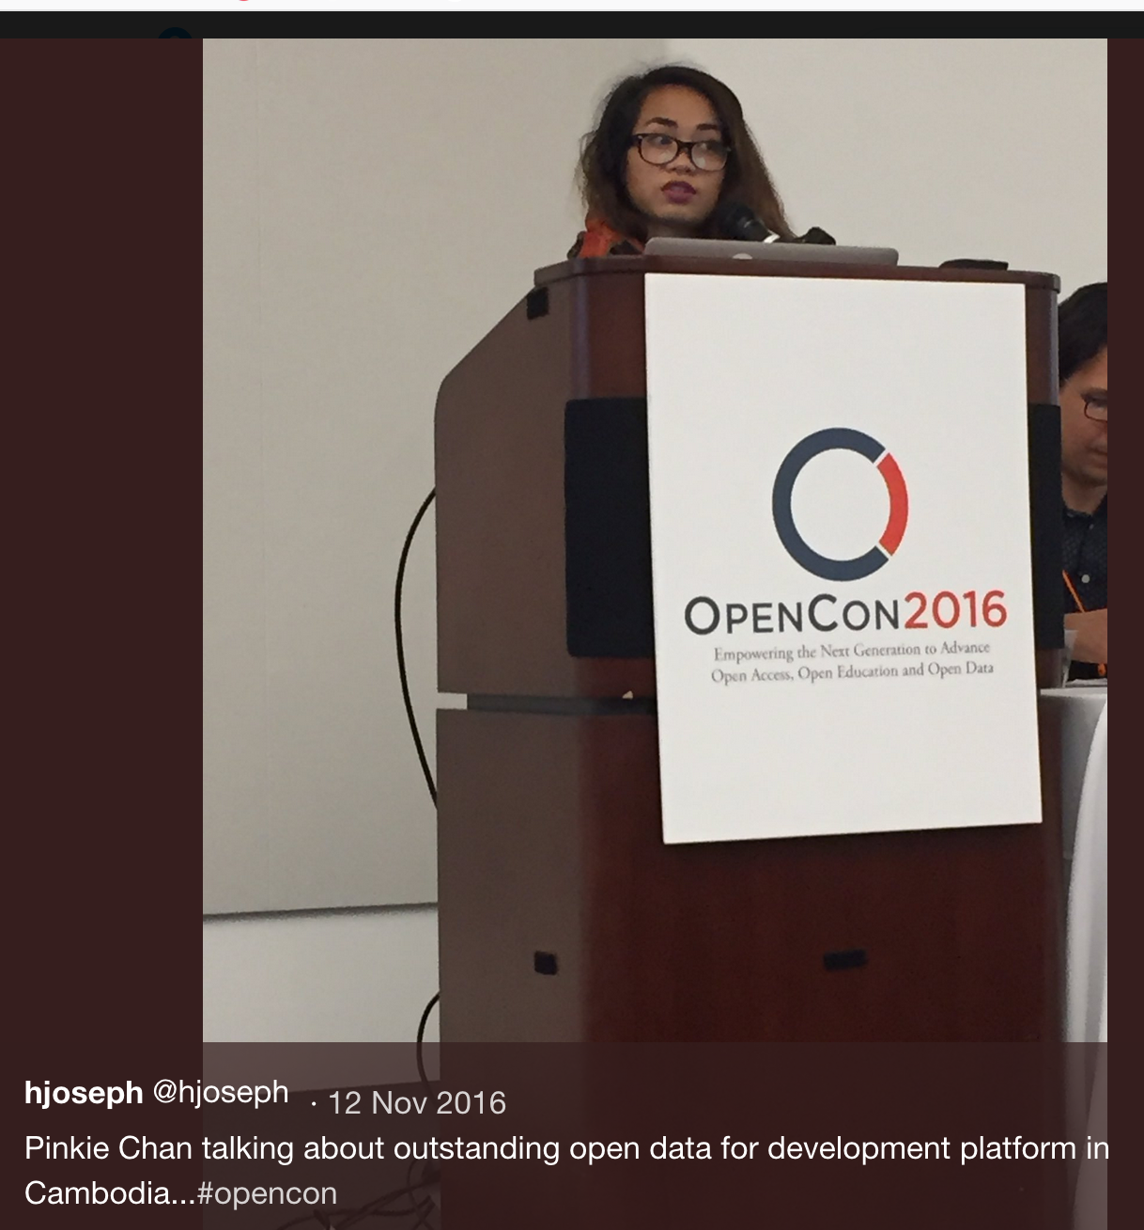
PMR’s Shuttleworth Flash Grantees
Erin McKiernan (Opencon)
Daniel Mietchen (Wikimedian)
Joe McArthur (Right to Research)
Chris Hartgerink (Opencon)
Pinkie Chan* (Fighting land grabs in Cambodia w OpenData)
Heather Piwowar (Impact Story, Unpaywall)
Corina Logan (Bullied into Bad Science)

Slide 28
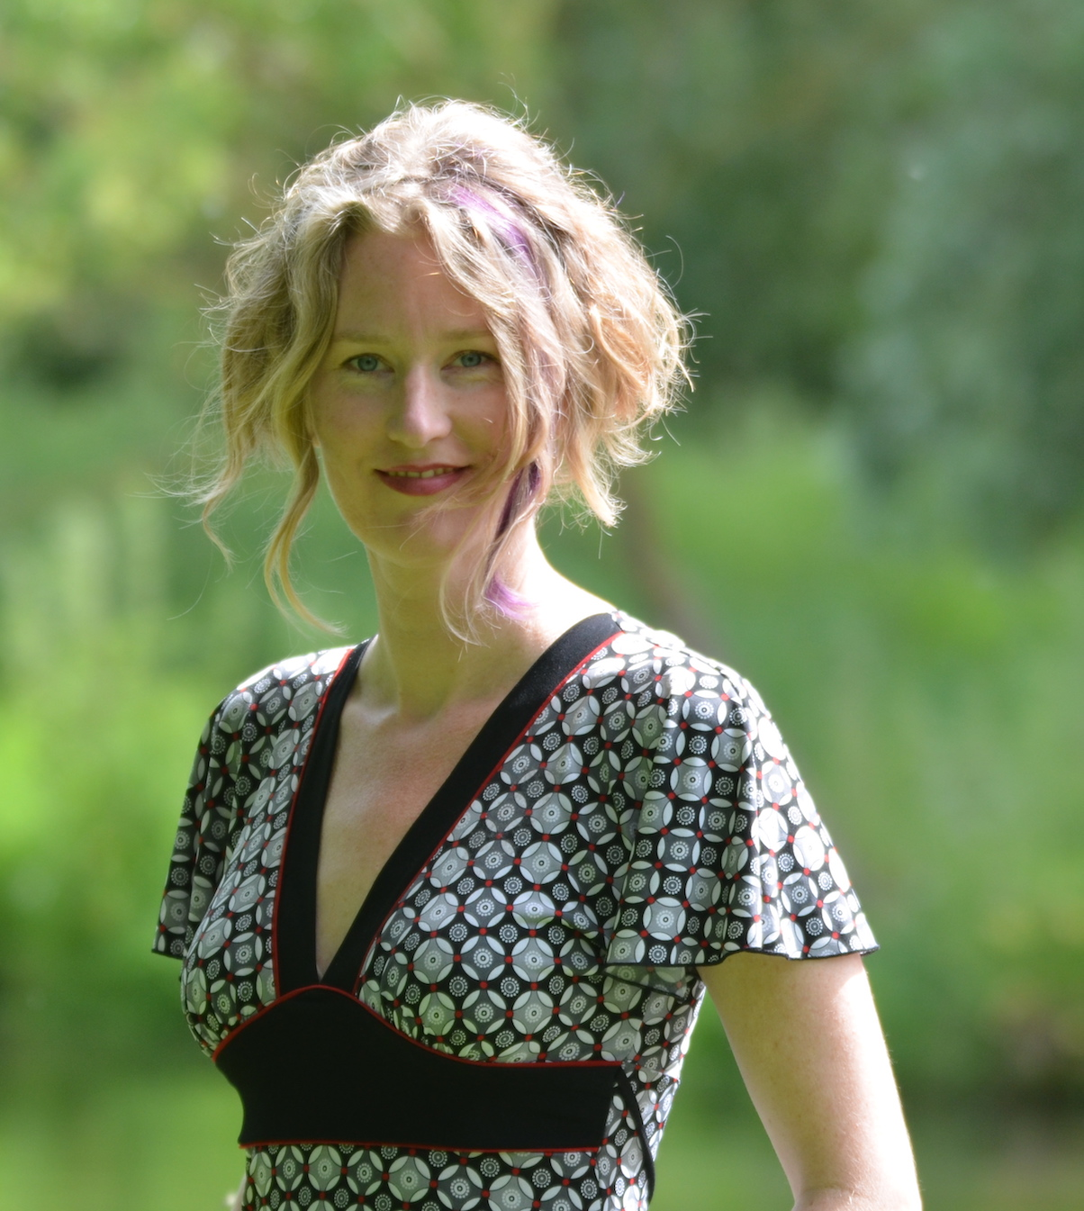
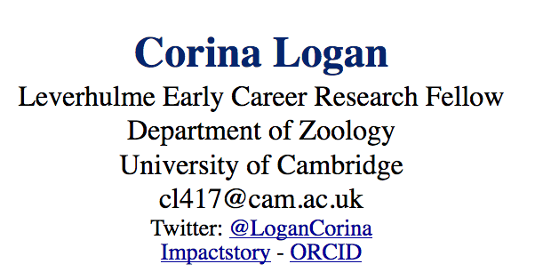
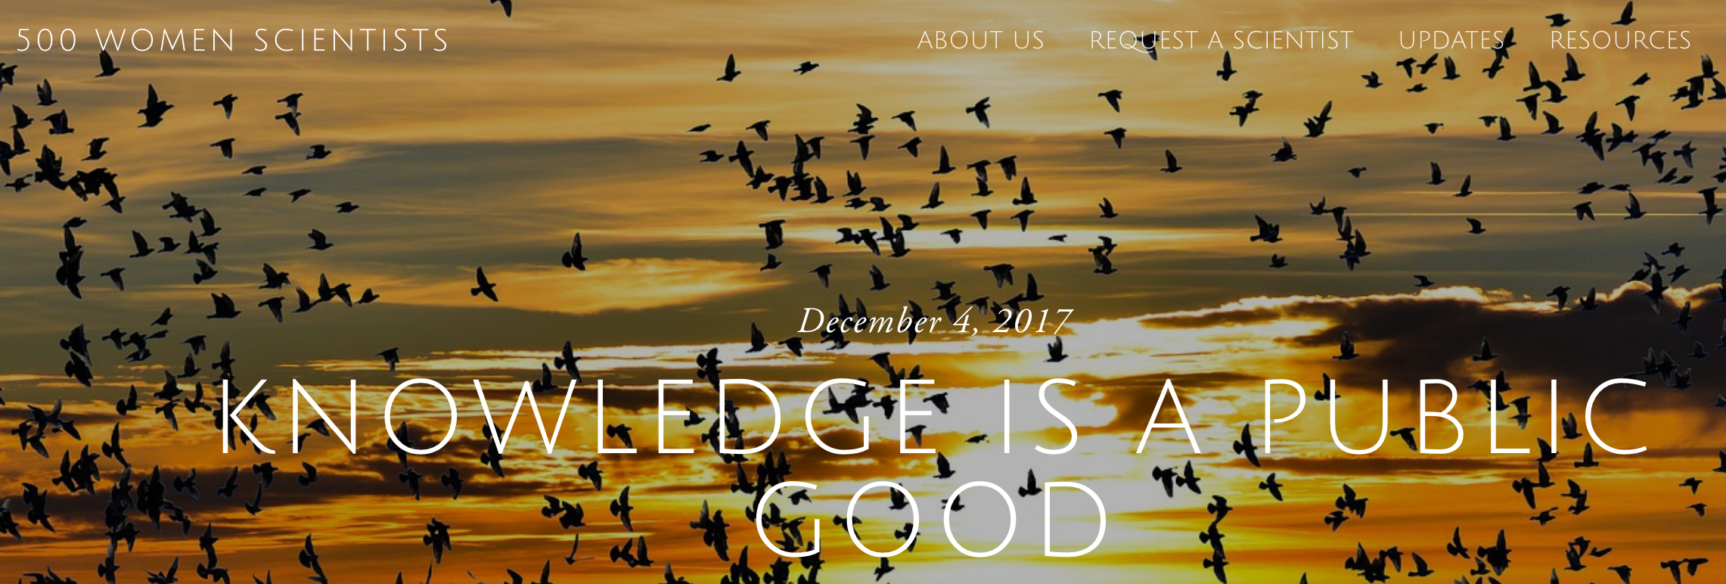
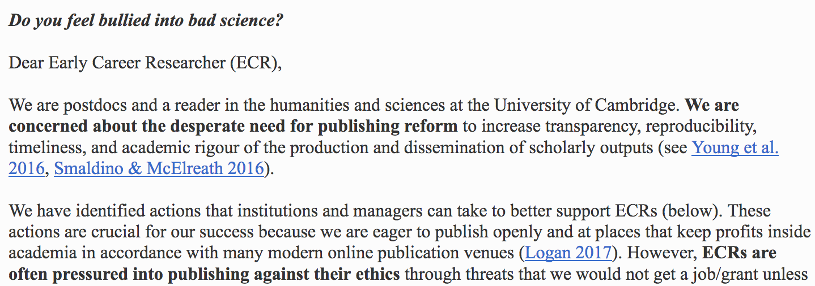
KNOWLEDGE IS A PUBLIC GOOD

Slide 29
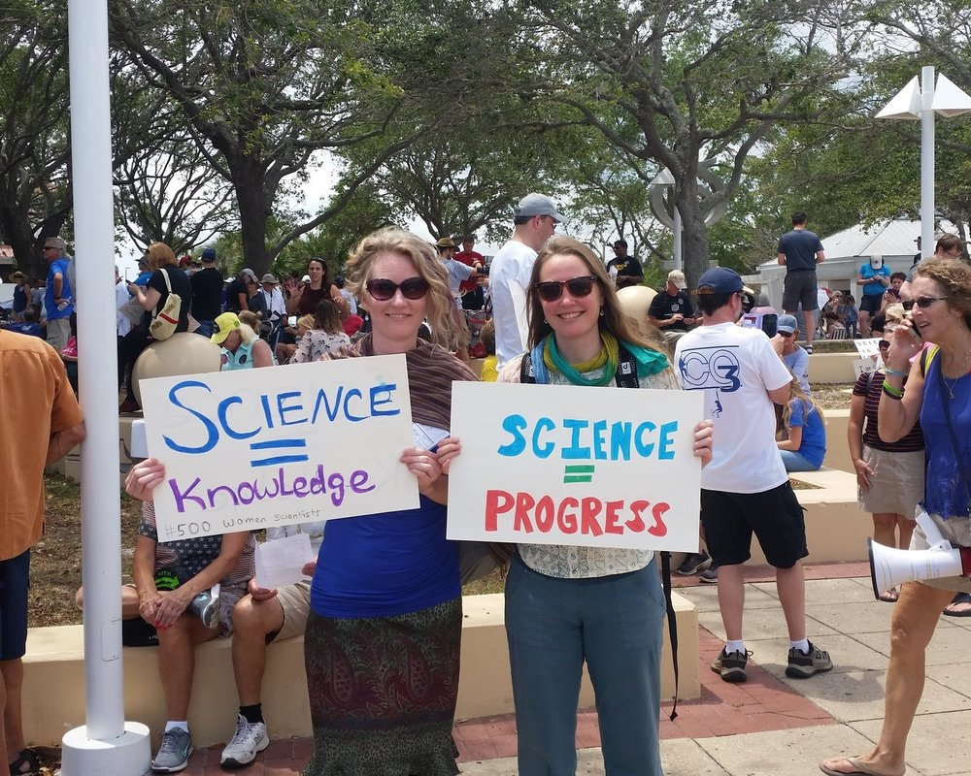

Slide 30
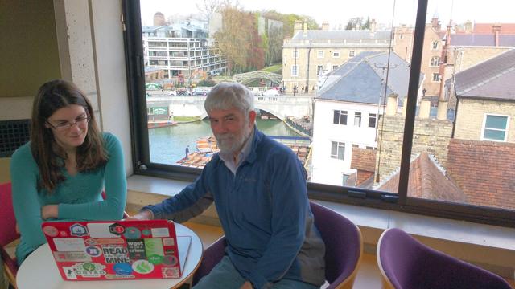
https://www.youtube.com/watch?v=1pGgBZes9Yg&index=5&t=0s&list=PLTdz0WcNX4rdYb4cDyesz7iYchIwMBYlD

Slide 31

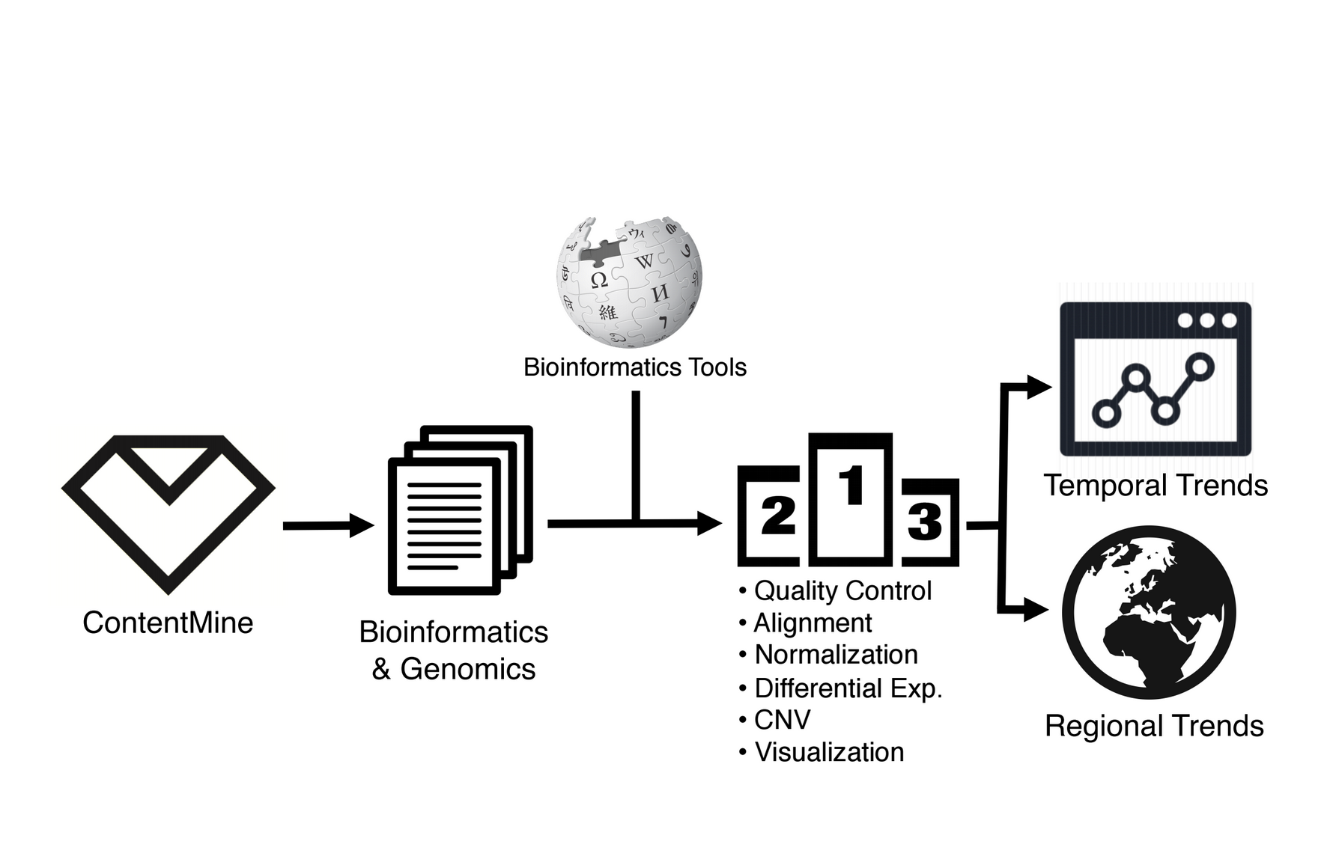
Neo Christopher Chung
Warsaw, Computational Biology
Wants to find out geographic and temporal differences in the use of genomic software tools

Slide 32
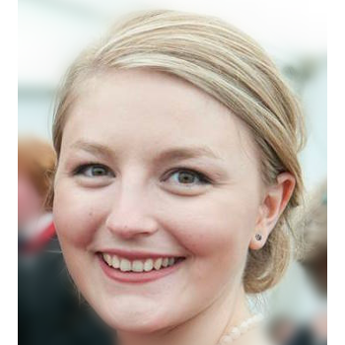
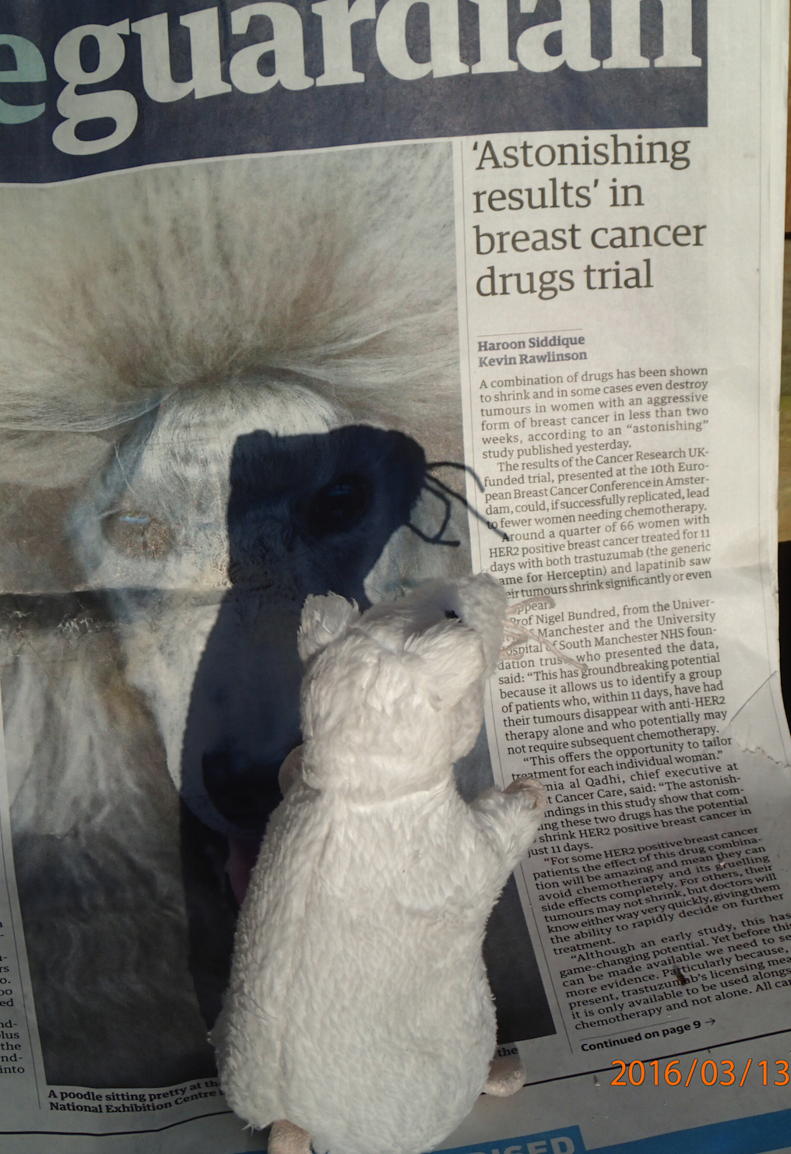
Alexandra Bannach-Brown
Edinburgh, Neuroscience
Problem: huge body of works in animal studies about depressions. systematic review is the main approach for getting insight.
Wants: identify papers in systematic review of depressive behaviour in animals. What drugs, what methods, what outcomes and signs/phenotypes. Use outcomes for document clustering.
and expedite scientific advances."
Corpus: 70.000 Papers

Slide 33

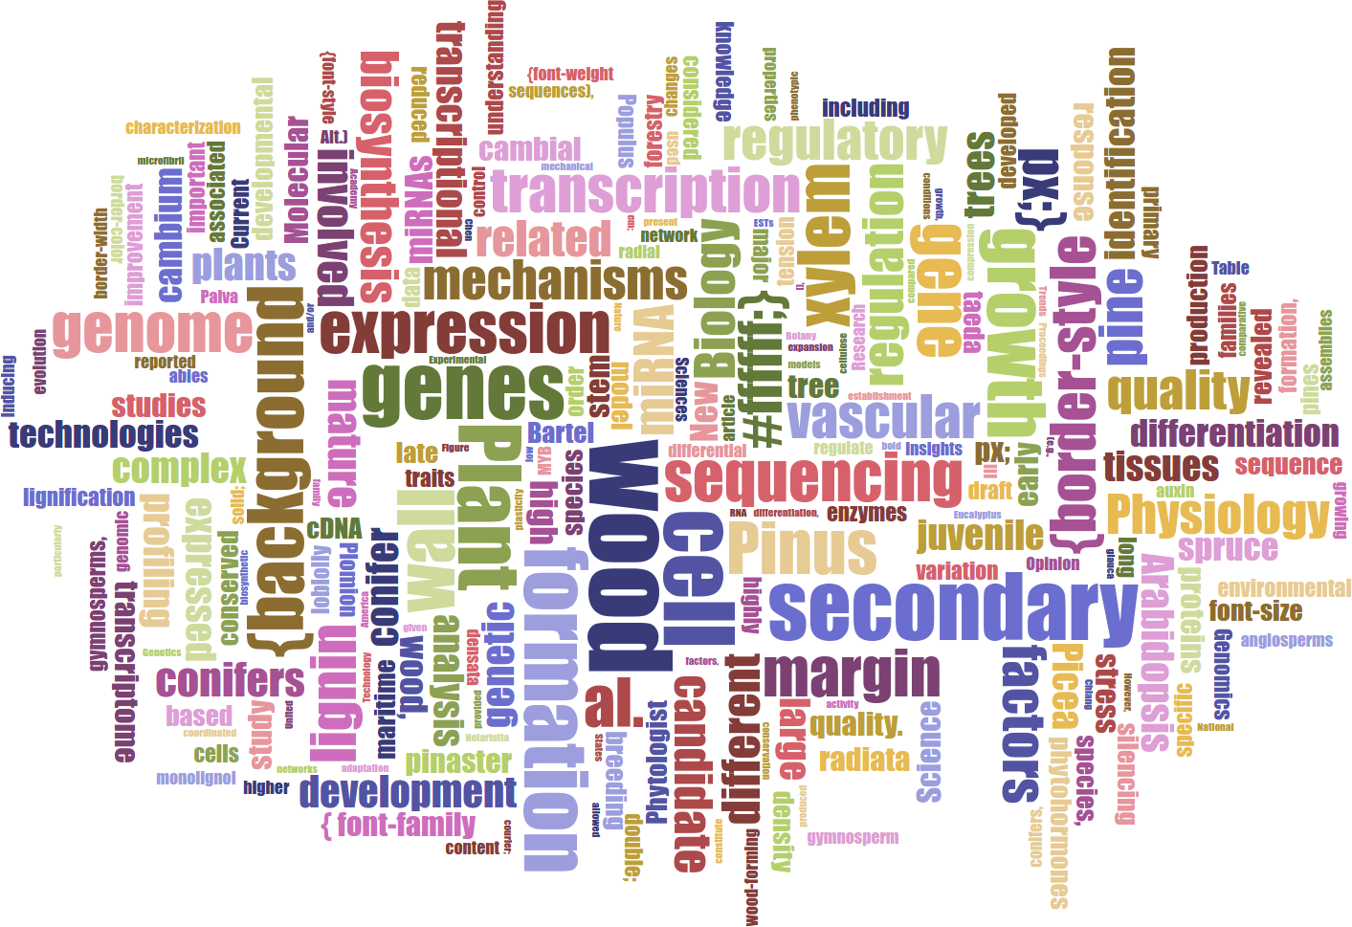
Lars Willighagen
15 years old NL
Wants: extract data about conifers (relations to chemicals, height etc.)
Outcome: database with webpage containing conifer properties
Table Facts Visualiser DEMO
Card DEMO
Word Cloud
„ I applied to this fellowship to learn new things and combine the ContentMine with two previous projects I never got to finish, and I got really excited by the idea and the ContentMine at large.“

Slide 34
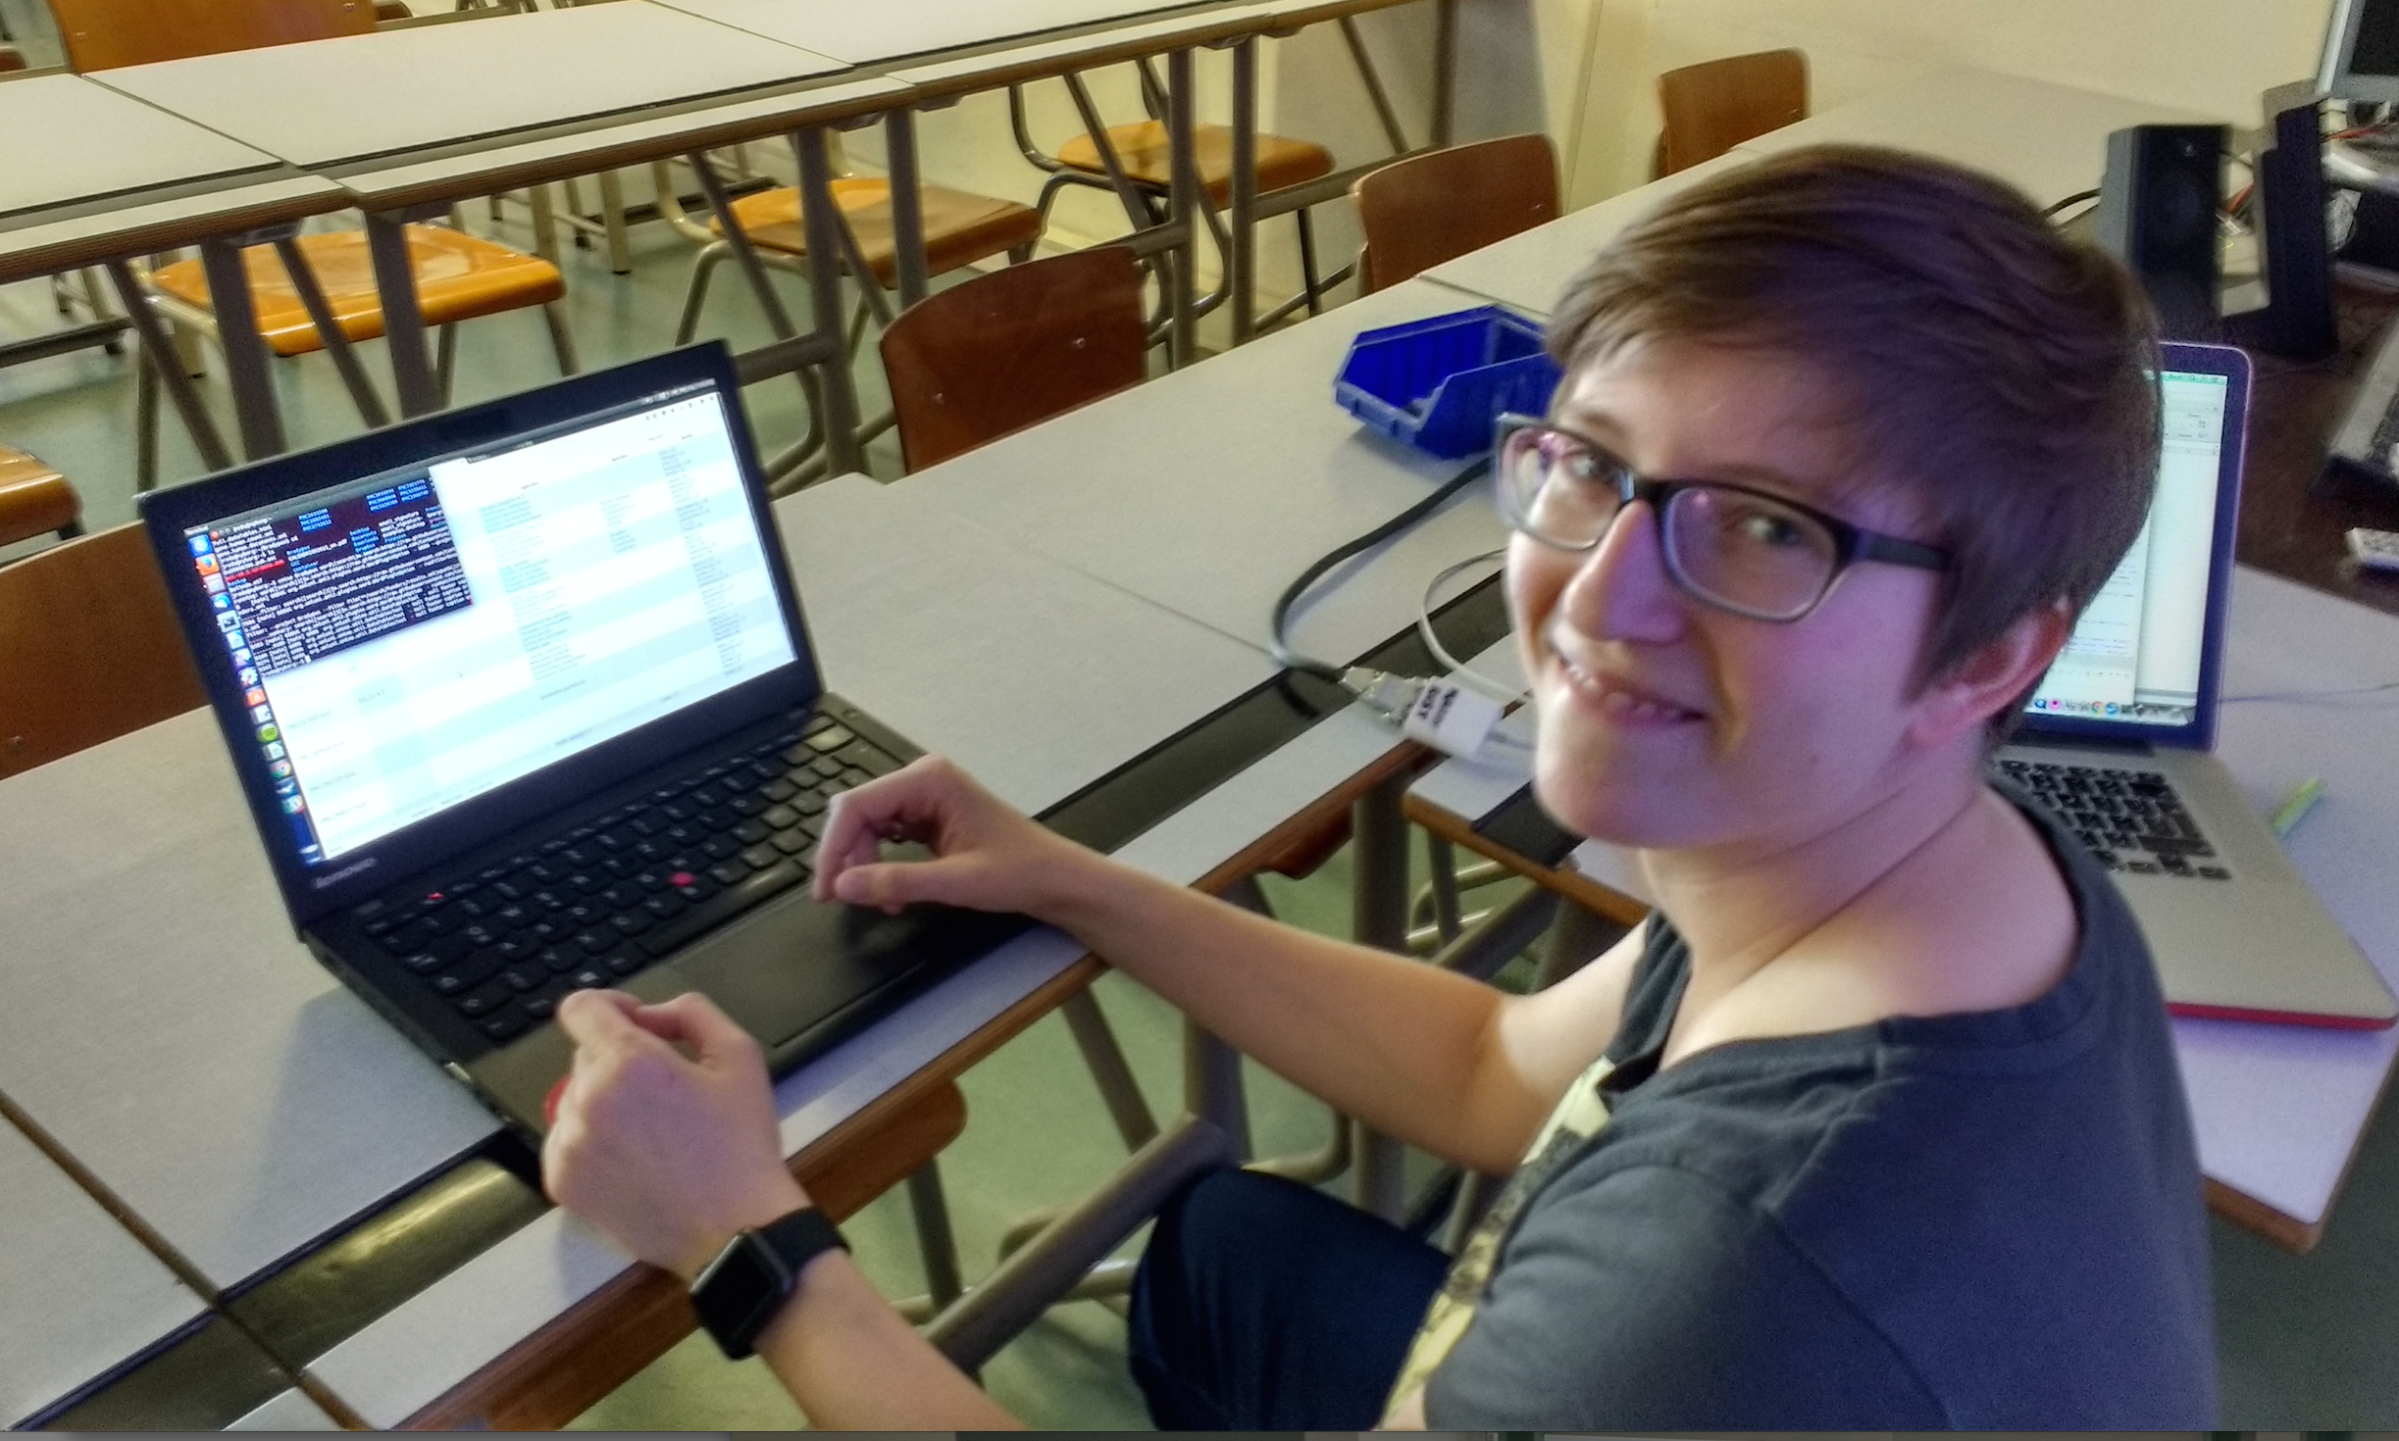
Julia Reda, Pirate MEP, running ContentMine software to liberate science 2016-04-16

Slide 35
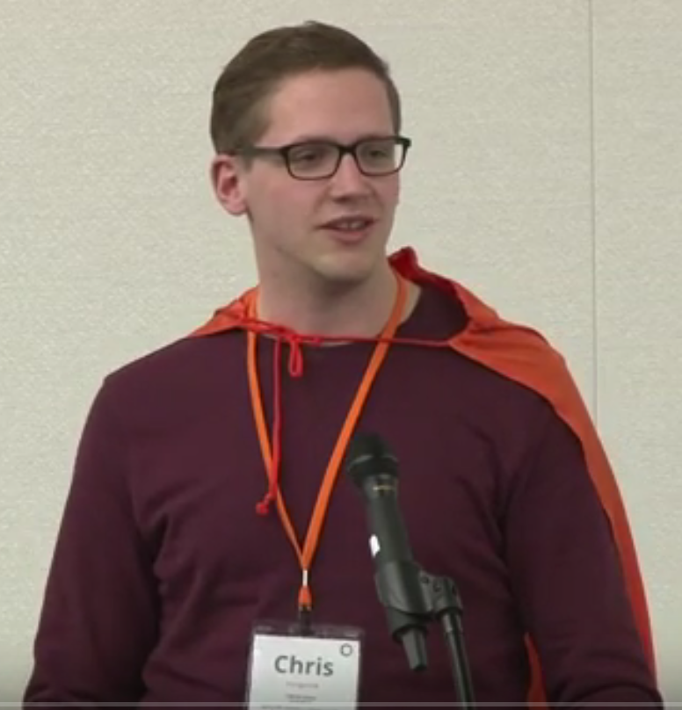
Chris Hartgerink
Tilburg University (NL)
Reproducible Science
Extracting statistical information
Helping authors check
reported results
Detecting problematic study
results (e.g., clinical trials)

Slide 36
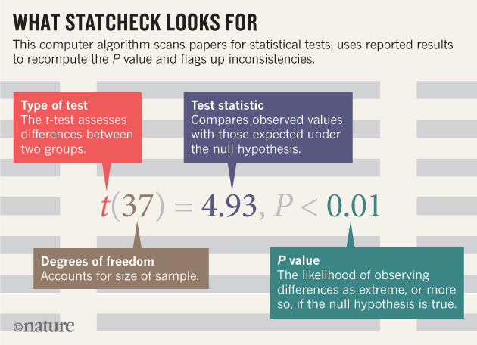
[1]
[1] STATCHECK from Chris Hartgerink

Slide 37
And now the main problem…

Slide 38
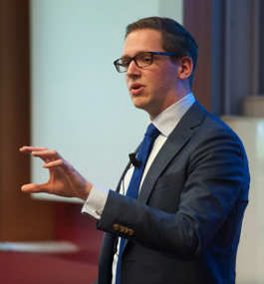
Elsevier stopped me doing my research
Chris Hartgerink
@Senficon (Julia Reda) :Text & Data mining in times of #copyright maximalism:
"Elsevier stopped me doing my research" http://onsnetwork.org/chartgerink/2015/11/16/elsevier-stopped-me-doing-my-research/ … #opencon #TDM

Slide 39
Chris Hartgerink’s blog post
I am a statistician interested in detecting potentially problematic research such as data fabrication, which results in unreliable findings and can harm policy-making, confound funding decisions, and hampers research progress.
To this end, I am content mining results reported in the psychology literature. Content mining the literature is a valuable avenue of investigating research questions with innovative methods. For example, our research group has written an automated program to mine research papers for errors in the reported results and found that 1/8 papers (of 30,000) contains at least one result that could directly influence the substantive conclusion [1].
In new research, I am trying to extract test results, figures, tables, and other information reported in papers throughout the majority of the psychology literature. As such, I need the research papers published in psychology that I can mine for these data. To this end, I started ‘bulk’ downloading research papers from, for instance, Sciencedirect. I was doing this for scholarly purposes and took into account potential server load by limiting the amount of papers I downloaded per minute to 9. I had no intention to redistribute the downloaded materials, had legal access to them because my university pays a subscription, and I only wanted to extract facts from these papers.
Full disclosure, I downloaded approximately 30GB of data from Sciencedirect in approximately 10 days. This boils down to a server load of 0.0021GB/[min], 0.125GB/h, 3GB/day.
Approximately two weeks after I started downloading psychology research papers, Elsevier notified my university that this was a violation of the access contract, that this could be considered stealing of content, and that they wanted it to stop. My librarian explicitly instructed me to stop downloading (which I did immediately), otherwise Elsevier would cut all access to Sciencedirect for my university.
I am now not able to mine a substantial part of the literature, and because of this Elsevier is directly hampering me in my research.
[1] Nuijten, M. B., Hartgerink, C. H. J., van Assen, M. A. L. M., Epskamp, S., & Wicherts, J. M. (2015). The prevalence of statistical reporting errors in psychology (1985–2013). Behavior Research Methods, 1–22. doi: 10.3758/s13428-015-0664-2

Slide 40
Wiley also stopped me (Chris Hartgerink) doing my research
In November, I wrote about how Elsevier wanted me to stop downloading scientific articles for my research. Today, Wiley also ordered me to stop downloading.
As a quick recapitulation: I am a statistician doing research into detecting potentially problematic research such as data fabrication and estimating how often it occurs. For this, I need to download many scientific articles, because my research applies content mining methods that extract facts from them (e.g., test statistics). These facts serve as my data to answer my research questions. If I cannot download these research articles, I cannot collect the data I need to do my research.
I was downloading psychology research articles from the Wiley library, with a maximum of 5 per minute. I did this using the tool quickscrape, developed by the ContentMine organization. With this, I have downloaded approximately 18,680 research articles from the Wiley library, which I was downloading solely for research purposes.
Wiley noticed my downloading and notified my university library that they detected a compromised proxy, which they had immediately restricted. They called it “illegally downloading copyrighted content licensed by your institution”. However, at no point was there any investigation into whether my user credentials were actually compromised (they were not). Whether I had legitimate reasons to download these articles was never discussed. The original email from Wiley is available here.
As a result of Wiley denying me to download these research articles, I cannot collect data from another one of the big publishers, alongside Elsevier. Wiley is more strict than Elsevier by immediately condemning the downloading as illegal, whereas Elsevier offers an (inadequate) API with additional terms of use (while legitimate access has already been obtained). I am really confused about what the publisher’s stance on content mining is, because Sage and Springer seemingly allow it; I have downloaded 150,210 research articles from Springer and 12,971 from Sage and they never complained about it.
http://onsnetwork.org/chartgerink/2016/02/23/wiley-also-stopped-my-doing-my-research/

Slide 41
Panton Principles for Open Data in science(2010)
PUBLISH YOUR DATA OPENLY
…make an explicit and robust statement of your wishes.
Use a recognized waiver or license that is appropriate for data.
open as defined by the Open Knowledge/Data Definition (… NOT non-commercial)
Explicit dedication of data … into the public domain via PDDL or CCZero
Peter Murray-Rust, Cameron Neylon, Rufus Pollock, John Wilbanks

Slide 42



Panton Authors and Fellows

Slide 43
The Hague Declaration on Knowledge Discovery in the Digital Age (2015)
INTELLECTUAL PROPERTY WAS NOT DESIGNED TO REGULATE THE FREE FLOW OF FACTS, DATA AND IDEAS, BUT HAS AS A KEY OBJECTIVE THE PROMOTION OF RESEARCH ACTIVITY
PEOPLE SHOULD HAVE THE FREEDOM TO ANALYSE AND PURSUE INTELLECTUAL CURIOSITY WITHOUT FEAR OF MONITORING OR REPERCUSSIONS
LICENSES AND CONTRACT TERMS SHOULD NOT RESTRICT INDIVIDUALS FROM USING FACTS, DATA AND IDEAS
ETHICS AROUND THE USE OF CONTENT MINING TECHNIQUES WILL NEED TO CONTINUE TO EVOLVE IN RESPONSE TO CHANGING TECHNOLOGY
INNOVATION AND COMMERCIAL RESEARCH BASED ON THE USE OF FACTS, DATA, AND IDEAS SHOULD NOT BE RESTRICTED BY INTELLECTUAL PROPERTY LAW
http://thehaguedeclaration.com/the-hague-declaration-on-knowledge-discovery-in-the-digital-age/
Drafted 2014-12 , convened by LIBER (Association of European Research Libraries)

Slide 44
Suggestions for collaboration/projects
Political/economic theory of knowledge neocolonialism
Data-driven literature mining for invasive plant species
Creation of semantic (machine-understandable) theses
Literature prediction of next global epidemic

Slide 45
Summary
Use knowledge to fight injustice
Collaborate
Don’t be afraid to ask! Or innovate…
Blog/tweet/video relentlessly
Be true to your values

Slide 46
http://contentmine.org

Slide 47

Prof. Ian Hargreaves (2011): "David Cameron's exam question”: "Could it be true that laws designed more than three centuries ago with the express purpose of creating economic incentives for innovation by protecting creators' rights are today obstructing innovation and economic growth?”
“yes. We have found that the UK's intellectual property framework, especially with regard to copyright, is falling behind what is needed.” "Digital Opportunity" by Prof Ian Hargreaves - http://www.ipo.gov.uk/ipreview.htm. Licensed under CC BY 3.0 via Wikipedia - https://en.wikipedia.org/wiki/File:Digital_Opportunity.jpg#/media/File:Digital_Opportunity.jpg

Slide 48

Asian and U.S. scholars continue to show a huge interest in text and data mining as measured by academic research on the topic. And Europe’s position is falling relative to the rest of the world.
Legal clarity also matters. Some countries apply the “fair-use” doctrine, which
allows “exceptions” to existing copyright law, including for text and data mining.
Israel, the Republic of Korea, Singapore, Taiwan and the U.S. are in this group.
Others have created a new copyright “exception” for text and data mining – Japan,
for instance, which adopted a blanket text-and-data-mining exception in 2009, and
more recently the United Kingdom, where text and data mining was declared fully
legal for non-commercial research purposes in 2014. Some researchers worry that
the UK exception does not go far enough; others report that British researchers are
now at an advantage over their continental counterparts.
the Middle East is now the world’s fourth largest region for research on text and data mining, led by Iran and Turkey.
http://www.lisboncouncil.net/publication/publication/134-text-and-data-mining-for-research-and-innovation-.html

Slide 49

Julia Reda MEP
there’s a serious risk of Europe digging itself deeper into a digital black hole on copyright,
Prof Ian Hargreaves:
…make sure that the voices of the digital many are not drowned out in policy discussions by the digitally self-interested few.
Julia Reda MEP
The current copyright regime is undermining our ability to produce evidence. It is time that academics in large numbers … speak up about this issue. Decreasing the very substantial burdens and transaction costs for research and education is one of the declared goals of the Commission’s copyright reform proposal, and the European Parliament has echoed that sentiment in my report.
http://www.create.ac.uk/blog/2015/09/16/epip2015-opening-keynote-response-transcript/

Slide 50
Copyright Problems
By default Copyright forbids everything until proved otherwise.
Clear answers are often only available when you defend yourself in court
Language is not precise.
“non-commercial”
“fair redistribution”
“public interest research organization”
Scientific Researchers using mining live in a constant state of Fear-Uncertainty-Doubt.
Legal reform is a necessary but not sufficient solution.

Slide 51




WikiFactMine has >500 expanded entries for “terpenes”

Slide 52

Search on publicly accessible papers on “Zika”
https://rawgit.com/ContentMine/amidemos/master/zika/full.dataTables.html

Slide 53


Slide 54
Infrastructure
Interoperates with SciPy, R-OpenSci, GitHub …
Fully Open (CC BY, Apache 2)

Slide 55


CONTENTMINE Complete OPEN Platform for Mining Scientific Literature
EuPMC, arXiv
CORE , HAL,
(UNIV repos)
Publisher Sites
Figures
query
Data
PloSONE, BMC, peerJ… Nature, IEEE, Elsevier…
PNG
EPS
crawl
getpapers
CSV
XLS
Daily
Crawl
URLs
DOIs
quickscrape
ToC
services
PDF HTML
DOC ePUB
TeX XML
queries
scrapers
Text
UNIV
Repos
Trials
Chem
INFRASTRUCTURE!
Normalizer
Structurer
Semantic
Tagger
COMMUNITY
norma
Phylo
taggers
Crystal
Plants
abstract
Captioned
Figures
search
plugins
methods
Fig. 1
Facts
catalogue
ami
references
HTML tables
Lookup
CONTENT
MINING
30, 000 pages/day Semantic ScholarlyHTML
Visualization
and Analysis

